Slide 1


CYBER FARM
DEVELOPED BY NEWLEAF GAMES
Pitching to Flight Fund

Slide 2
ABOUT US

Slide 3
OUR VISION
At NewLeaf Games, we aim to make fun and cozy games for casual and beginner gamers. We want to put out a product which will help people wind down after a long day of work and can be enjoyed on the go.

Slide 4





MEET THE TEAM
LORENA-MARIA NEAGOE
LOLA HUSTON
SIMONE LYNCH
JUNG-HWA RYU
JOHN JIMMY
Lead 2D Artist
2D Artist & Animator
Junior Animator & UI Artist
Junior Programmer
Lead Programmer

Slide 5
OUR EVOLUTION
2019
2020
2021
2022
Outsourcing company founded by junior game designers & artists
Had our artists work on “Dream and Chronicle” board game
Started developing our first IP game, “Death Machine”
Successfully released “Death Machine” on Steam

Slide 6
WHAT SETS US APART?
Our projects are for everyone to enjoy. We love exploring and bending all kinds of genres and character concepts and backgrounds
We listen to what people want. A new tycoon game? We’ll make it.
We never put out half of a project! We have high standards for our work and will always ensure the project is in a great condition before release!

Slide 7
OBJECTIVES
SHORT TERM
SUCCESSFULLY FINISH DEVELOPING THE GAME
RELEASE THE GAME ON MOBILE, SWITCH AND STEAMDECK
Finish creating and implementing all assets, SFX etc.
Proposed release for 5th of March 2024
FILL A NEGLECTED NICHE IN THE GAMING MARKET
We are aware of the lack of cozy games compared to mature, violent, games and we aim to change that.
LONG TERM

Slide 8

ABOUT OUR GAME
Provide shelter for as many cute robots as you can!

Slide 9
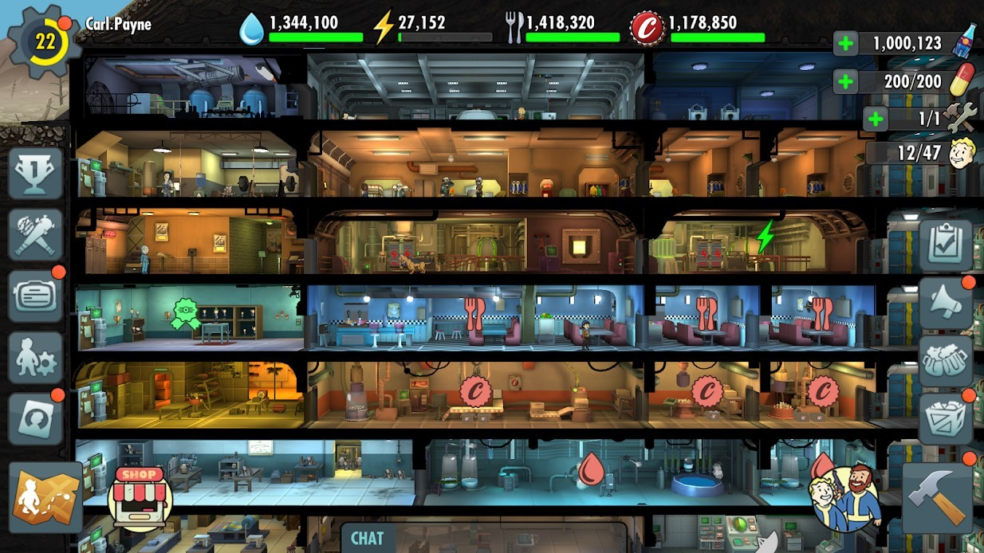
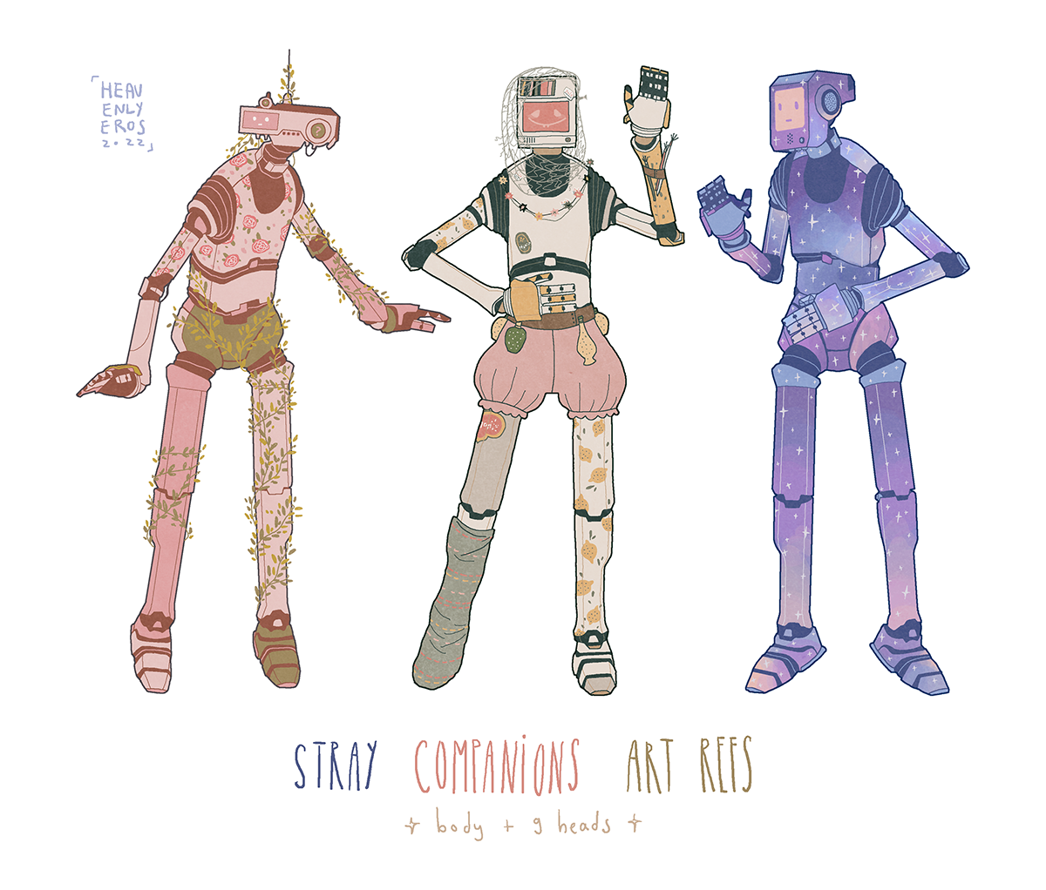
YOUR NEXT OBSESSION ON THE GO!
Cyber Farm is a cute, 2D pixel art & retro style construction & management simulation game. The gameplay is pretty simple:
Upgrade & expand your bunker
Assign your overly cute robots tasks depending on their skills
Keep them happy or resource production will be more difficult
Collect as many of them as you can!
Pretty simple, right? Anyone can play this game! And since we aim for mobile and handheld consoles release, this game is perfect for people looking for something to keep them busy on their way to school or work!
”Fallout Shelter” inspired level layout
Character concepts by heavenlyeros

Slide 10
STRATEGY

Slide 11
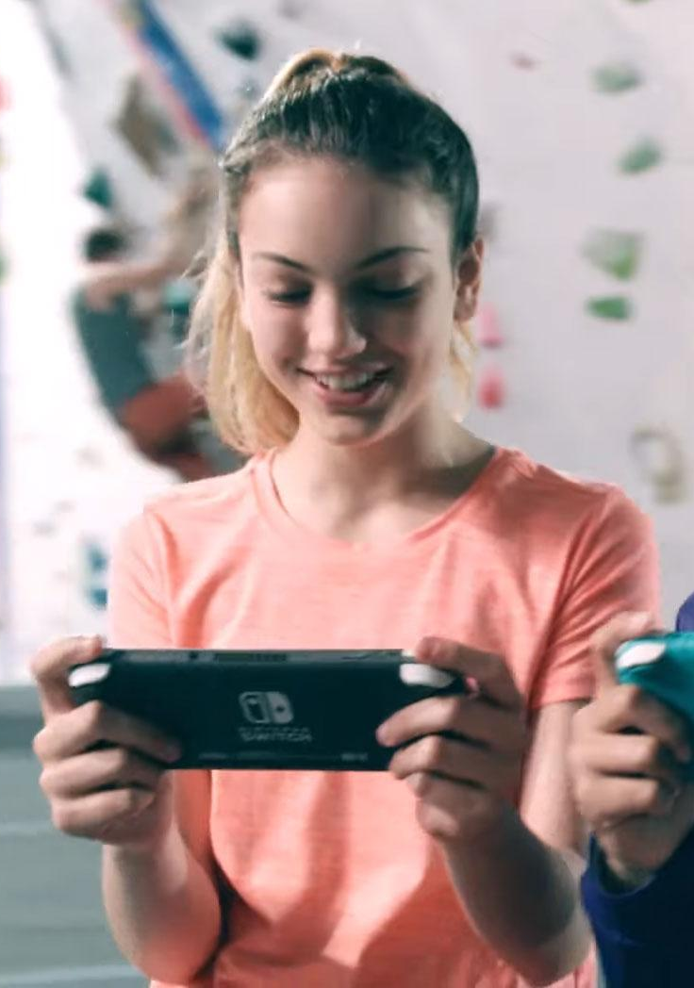
USER PERSONA PROFILE
AGE RANGE
INTERESTS
12+
Cozy Games
90%
Retro
80%
TARGET LOCATIONS
Sci-Fi
30%
Romania
Germany
TARGET AUDIENCE
United Kingdom
U.S.
Casual gamer, a person that likes on-the-go cute, cozy & retro games.
Australia
Japan
South Korea
Someone who enjoys construction & management simulation games.

Slide 12
PRODUCTION SCHEDULE
1
PRE-PRODUCTION (MONTHS 1-3)
Interviewing & signing contracts with freelancers
Concept art
Early prototyping
Technological capabilities
2
PRODUCTION (MONTHS 4-14)
Characters & level assets creation + implementation
SFX creation + implementation
Physics & mechanics implementation
Testing & bug fixing
3
POST-PRODUCTION
(MONTHS 15-16)
Marketing campaign (pre & post lunch)
More bug fixing
Game patching

Slide 13
BUDGET
TEAM SALARIES
200,000
TEAM SOFTWARE LICENCES
7,241
FREELANCERS
150,000
MARKETING
100,000
CONTINGENCY
42,759
500,000

Slide 14
THANKS!
Do you have any questions?
21433766@student.uwl.ac.uk
https://21433766.wixsite.com/lorenamarianeagoe
Please keep this slide for attribution

Slide 15
REFERENCES LIST
Presentation template - https://slidesgo.com/theme/retro-videogames-mk-plan?
“Meet the team” pictures - https://picrew.me/image_maker/112842
Robots concept art - https://heavenlyeros.tumblr.com/post/692030903485071360/inspired-by-a-post-by-the-colossal-here-are
User persona pic - https://www.techradar.com/news/nintendo-switch-lite-is-available-to-pre-order-starting-today
Company logo - https://www.brandcrowd.com

