Slide 1
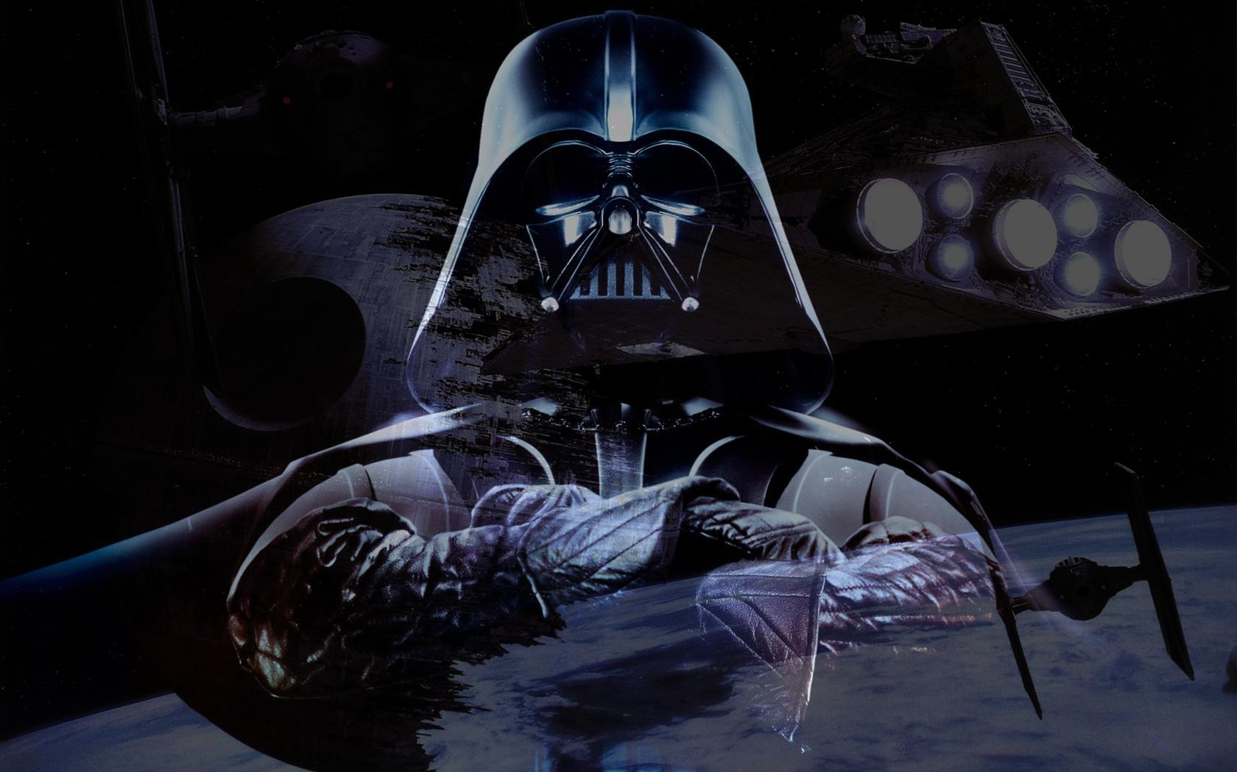
FMP: Star Wars art bible
by Lorena-Maria Neagoe

Slide 2
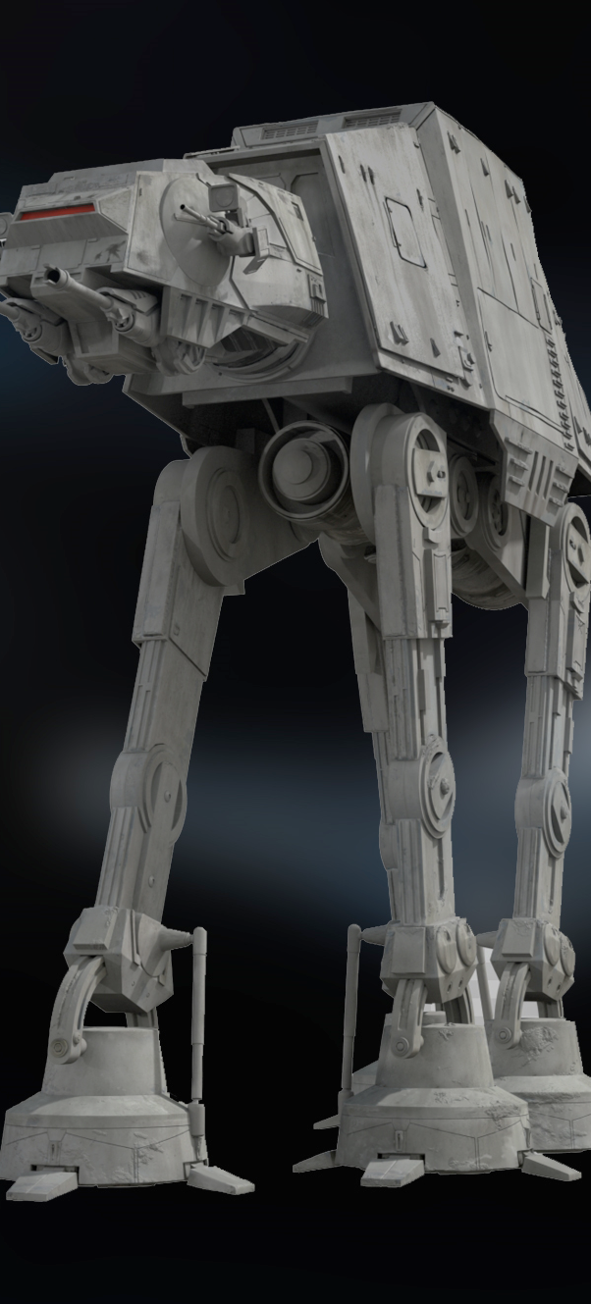
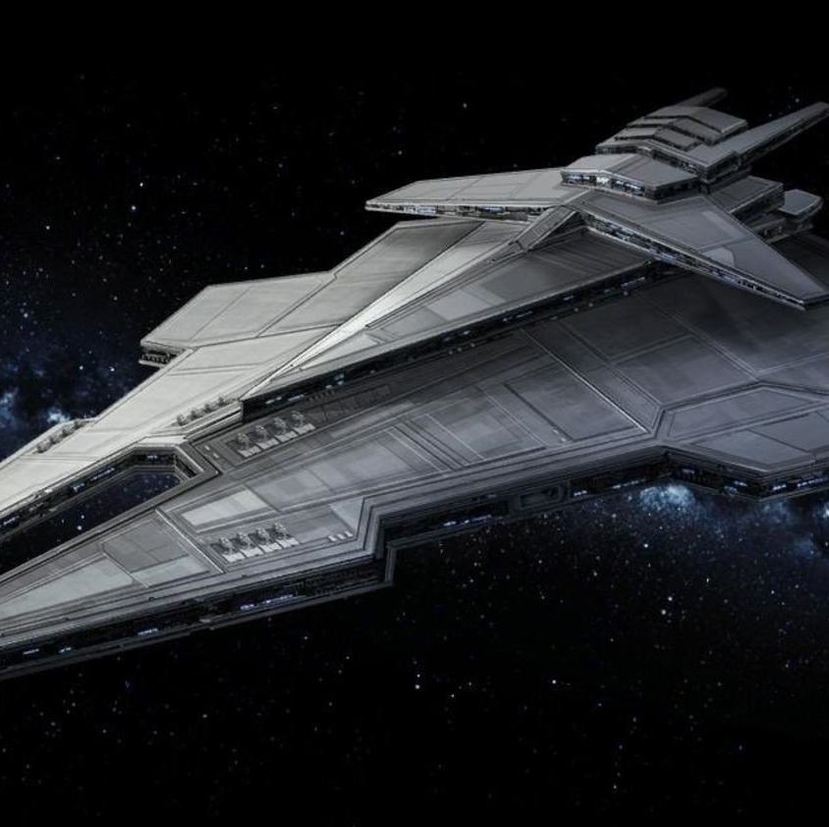
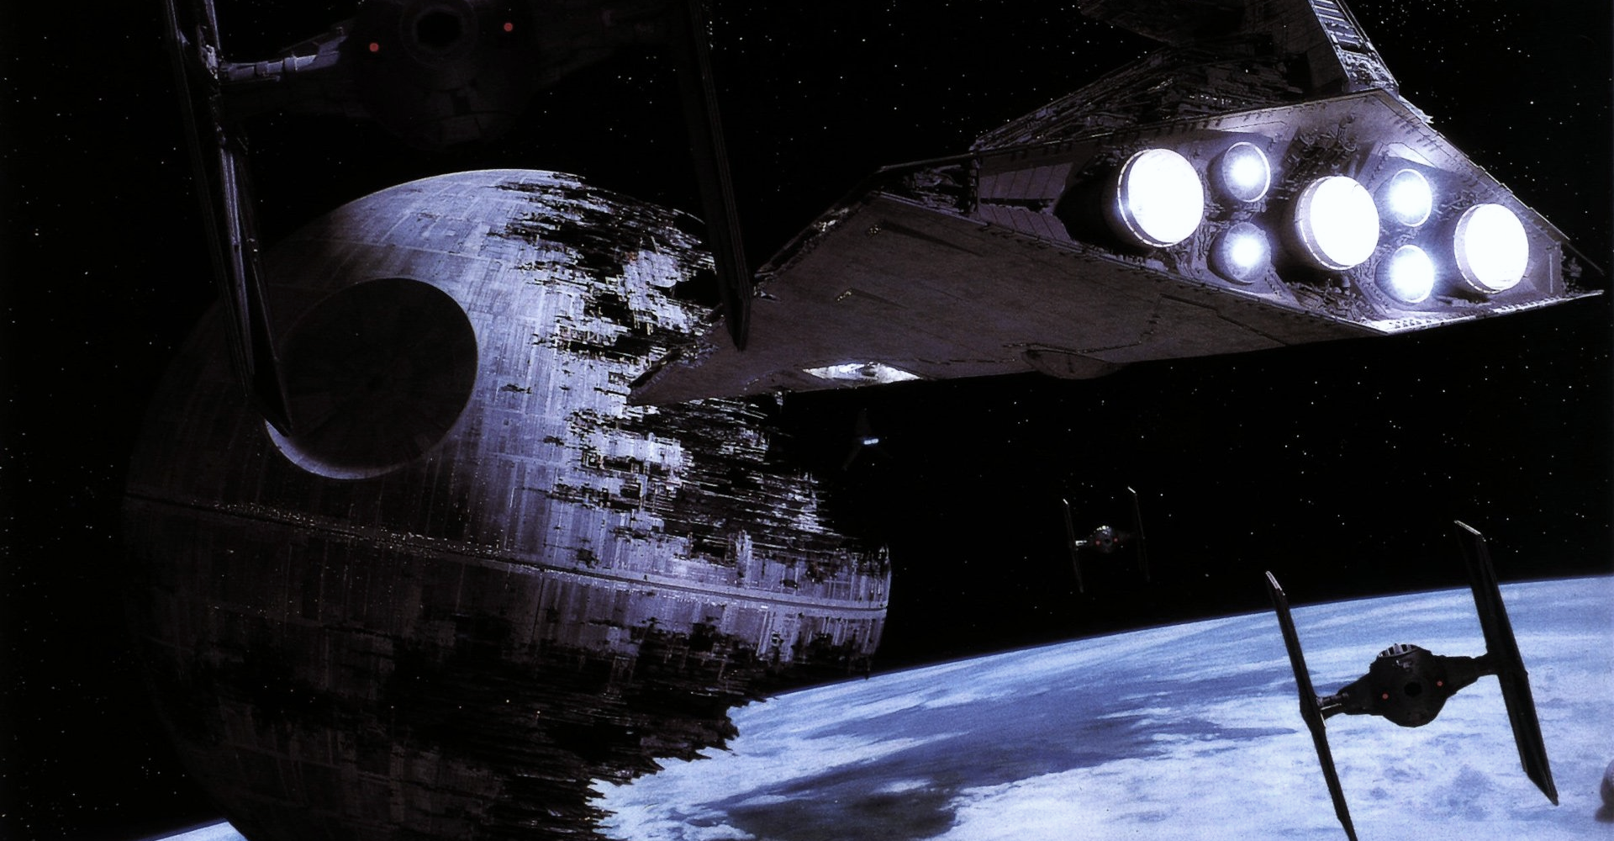
Table of contents
Introduction
Goals & Objectives
Moodboards
Characters
Planet, its ecosystem & native species

Slide 3
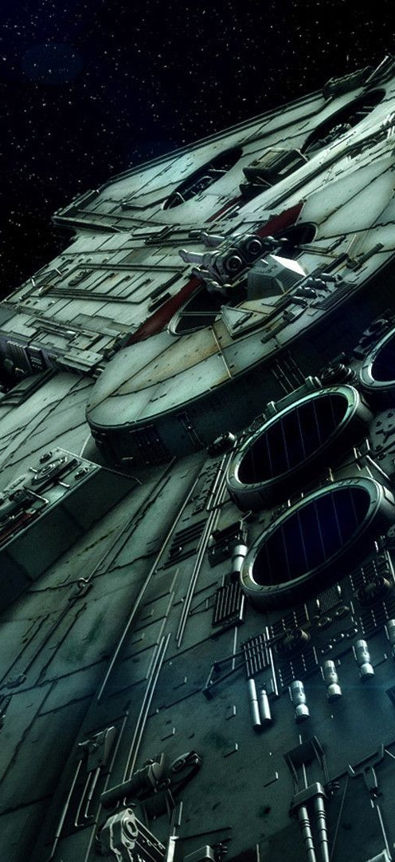
Intro
For my final major project I chose to do an art bible for the next Star Wars game.
With this project I aim to touch some aspects that we don’t quite see much of, although the universe is quite vast. Briana Raucci points out that “the most apparent characteristic that the universe seems to lack, though, is the one thing that makes our world so special: diversity.”
Having mentioned this, for my project I’ll be designing an alien female character as the main character, as well as a diverse cast of aliens from all around the Galaxy, as well as designing a brand new planet, ecosystem and native humanoids living there.

Slide 4
Goals & Objectives
SERVICES
Design a variety of characters
Design a new planet and ecosystem
Design props, accessories and weapons
Have a great portfolio piece showcasing my design skills
The characters I have planned for now are:
Female Twi’lek (Main Character)
Female Mon Calamari (main antagonist)
Male Mirialan (side character)
Bounty hunter droid (side character)
I will create a floating island-like planet that will be a Rebel base, as well as come up with flora, fauna and a native humanoid alien species.
I’m mostly going to design blasters and rifles, no lightsabers, although one of the weapons I’m looking forward to designing the most is a kyber crystal/lightsaber rifle, only seen in a couple of comic books so far.
My long-term goal of this project is to have a cool piece of work in my portfolio that I can proudly show off to recruiters and will hopefully help me land a job in the industry.

Slide 5
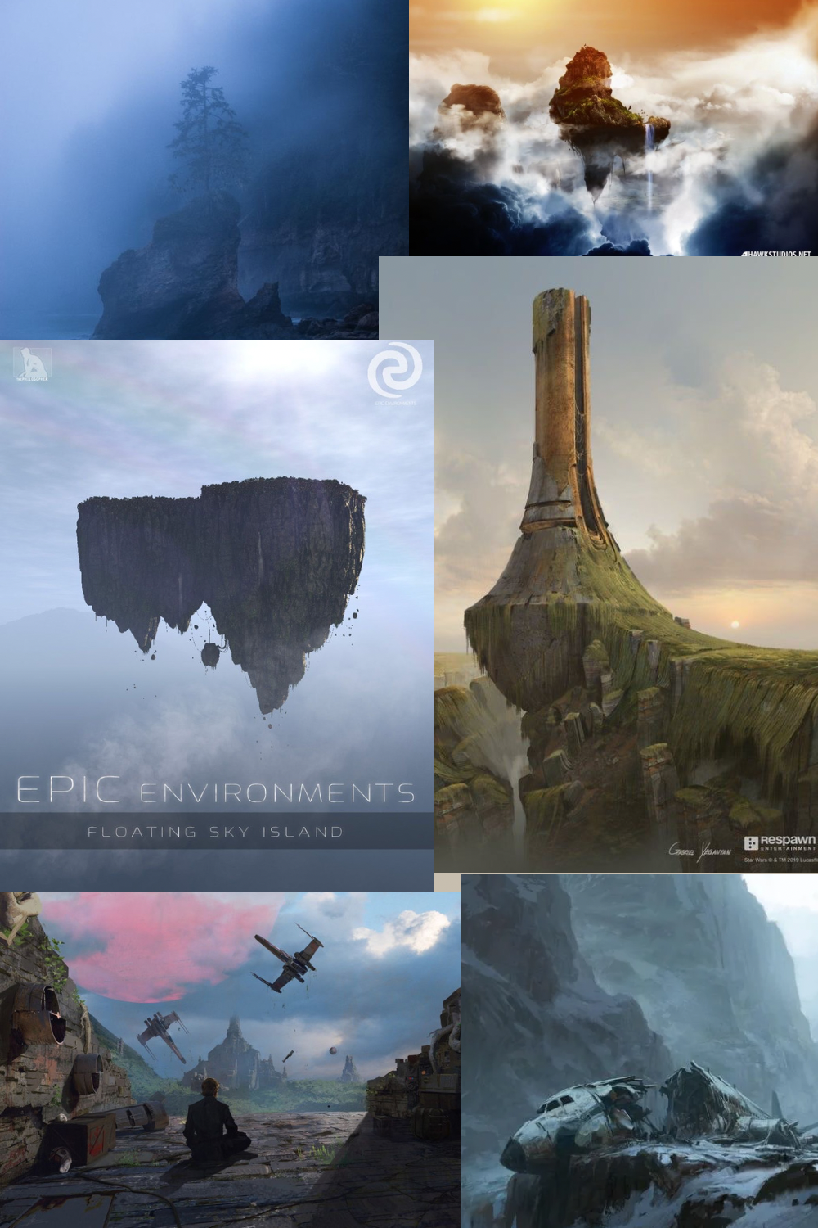
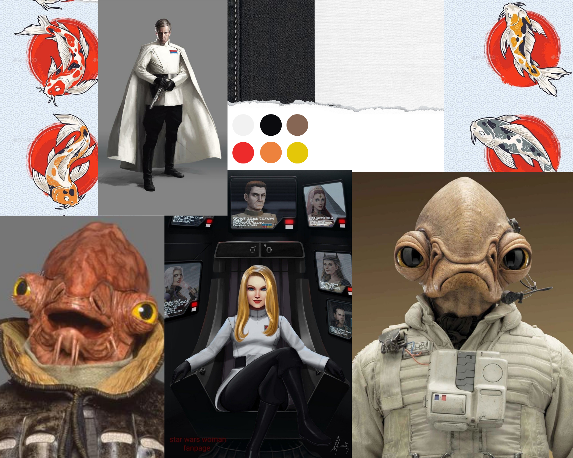
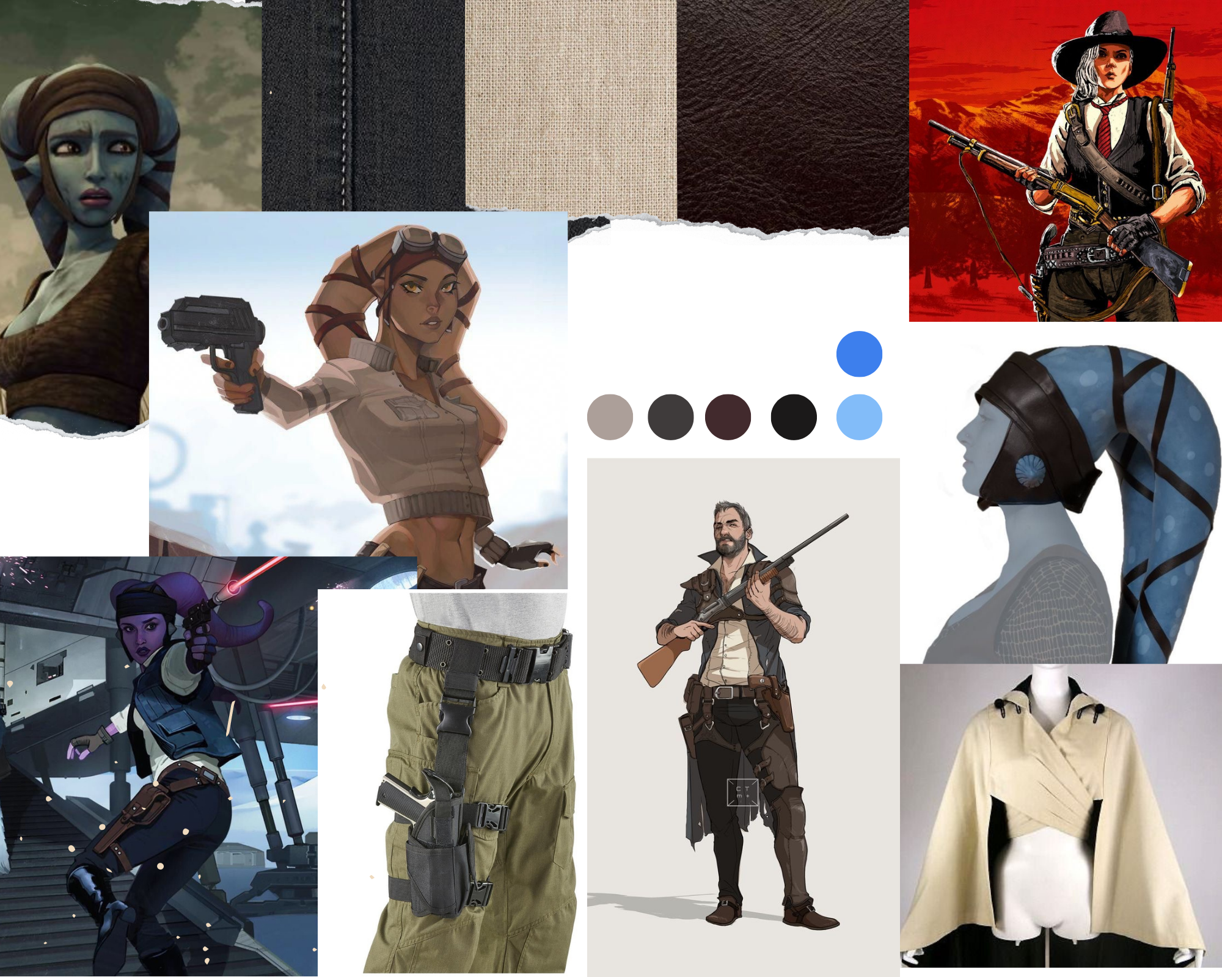
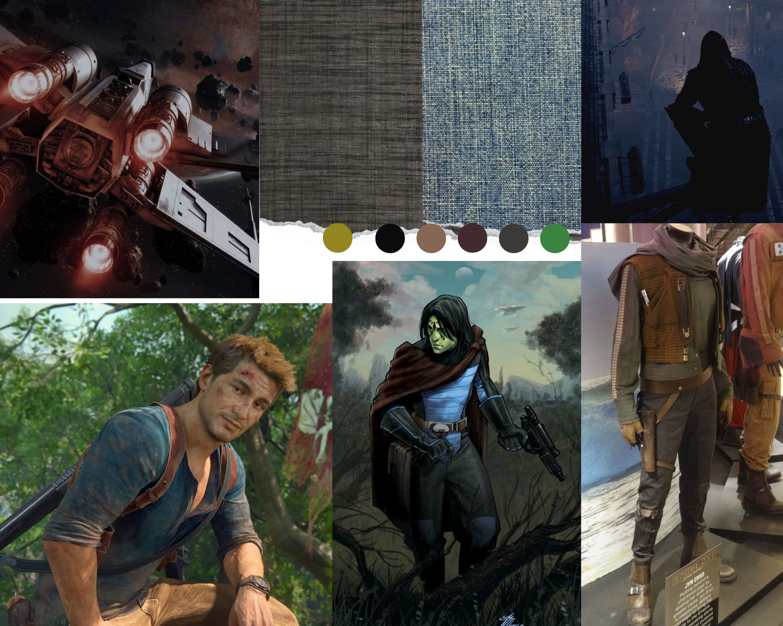
Moodboards
https://masterbundles.com @ Copyright. All Rights Reserved.

Slide 6
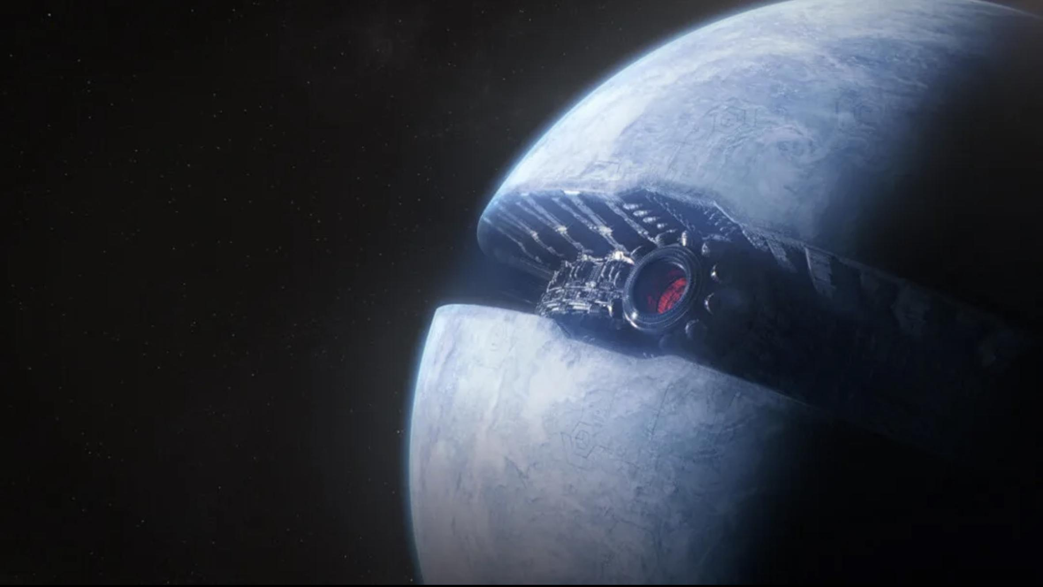
Characters

Slide 7
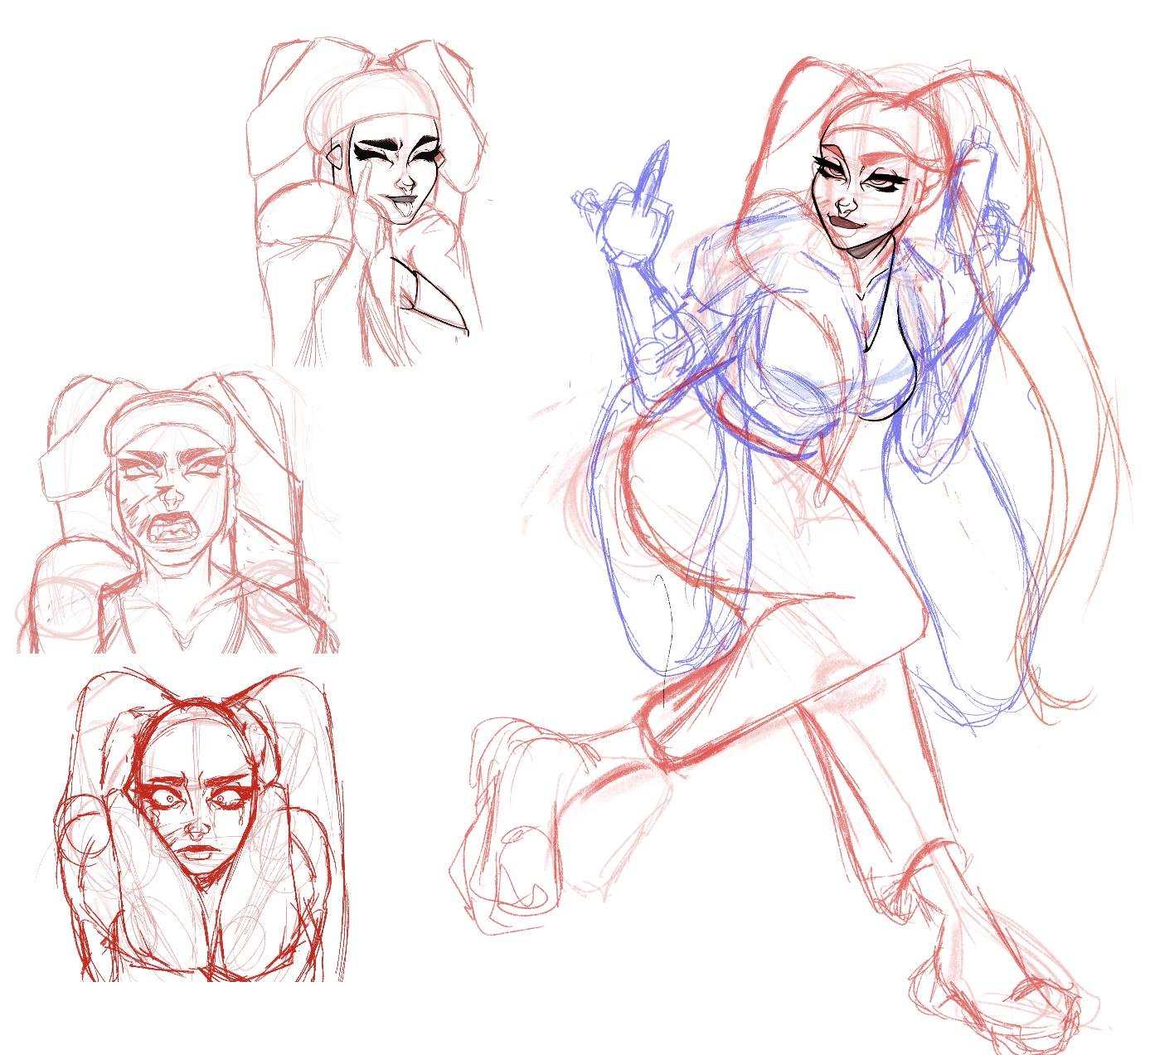
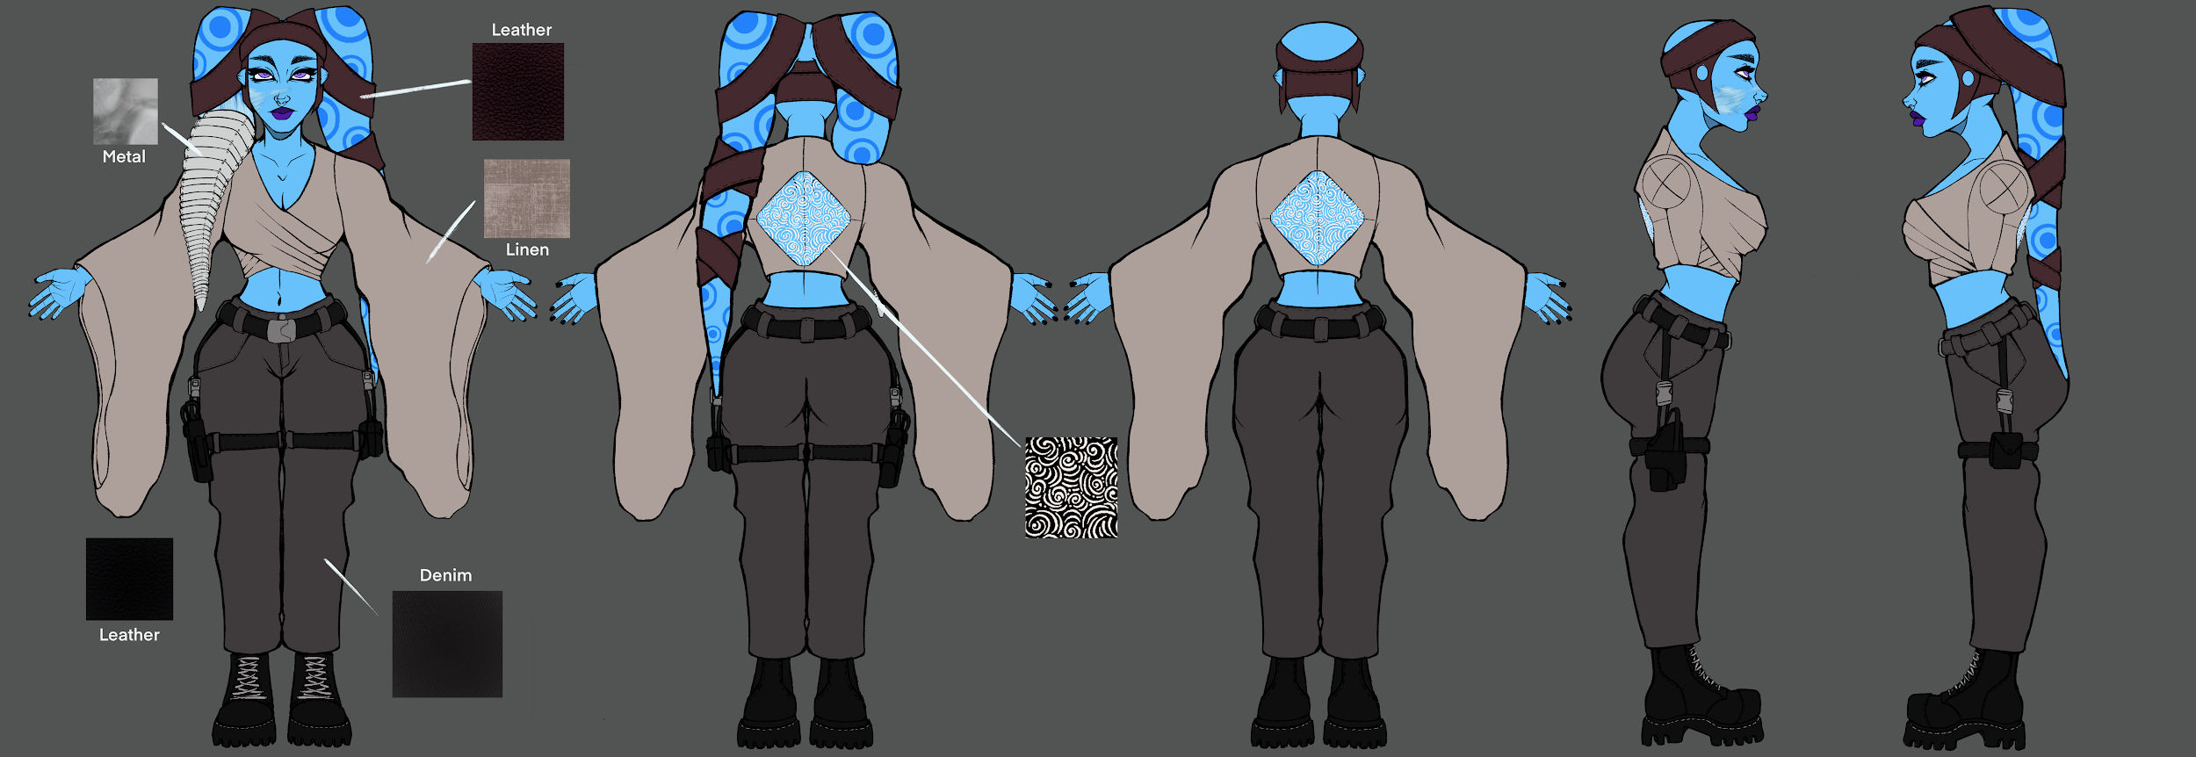
Main Character: Ovasu Nolaa
This character is a Twi’leak female. A very important part of her design is that she lost one of her lekku (the tails on her head), which will also affect a big part of her personality. Throughout the Star Wars media, Twi’leki (their native language) is a mixture of words and lekku movement and signs, therefore if you don’t have lekku you are automatically going to speak a broken version of the language, even though you are fluent with the words. Because of this, Ovasu can’t properly speak her native language anymore.
Although she is a strong character, a fighter and does everything to accomplish her missions and bring positive change to the galaxy, her accident left her self-conscious around other Twi’leks. She feels disconnected from her people and her roots. She doesn’t let others know how she actually feels, so she’s always acting very confident and sometimes goofy around others, even though deep down she doesn’t feel like it.
I want to portray this duality of hers in her designs and most importantly, in her emotions and her expression sheet.
Her lekku prosthetic is made out of metal and it helps balance out the weights on her head.
She is a spy and more of a gunslinger when it come to her weapons of choice, which are blasters and rifles, which I will design soon.

Slide 8
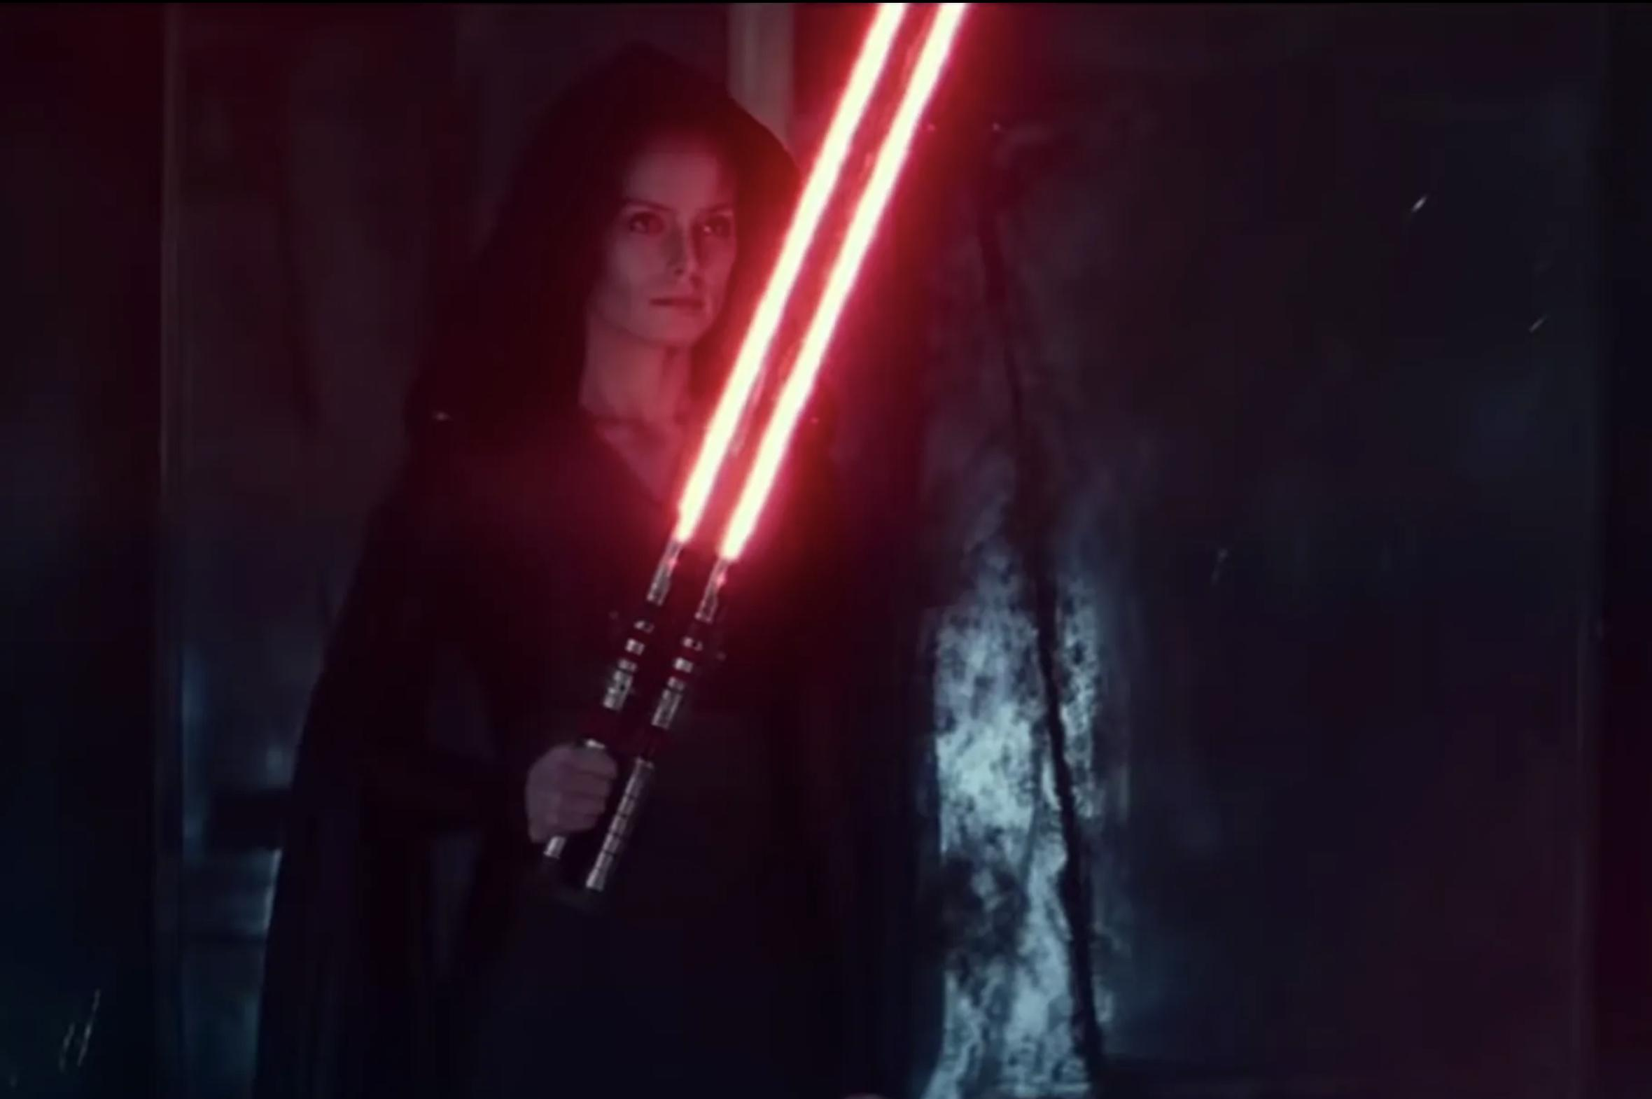
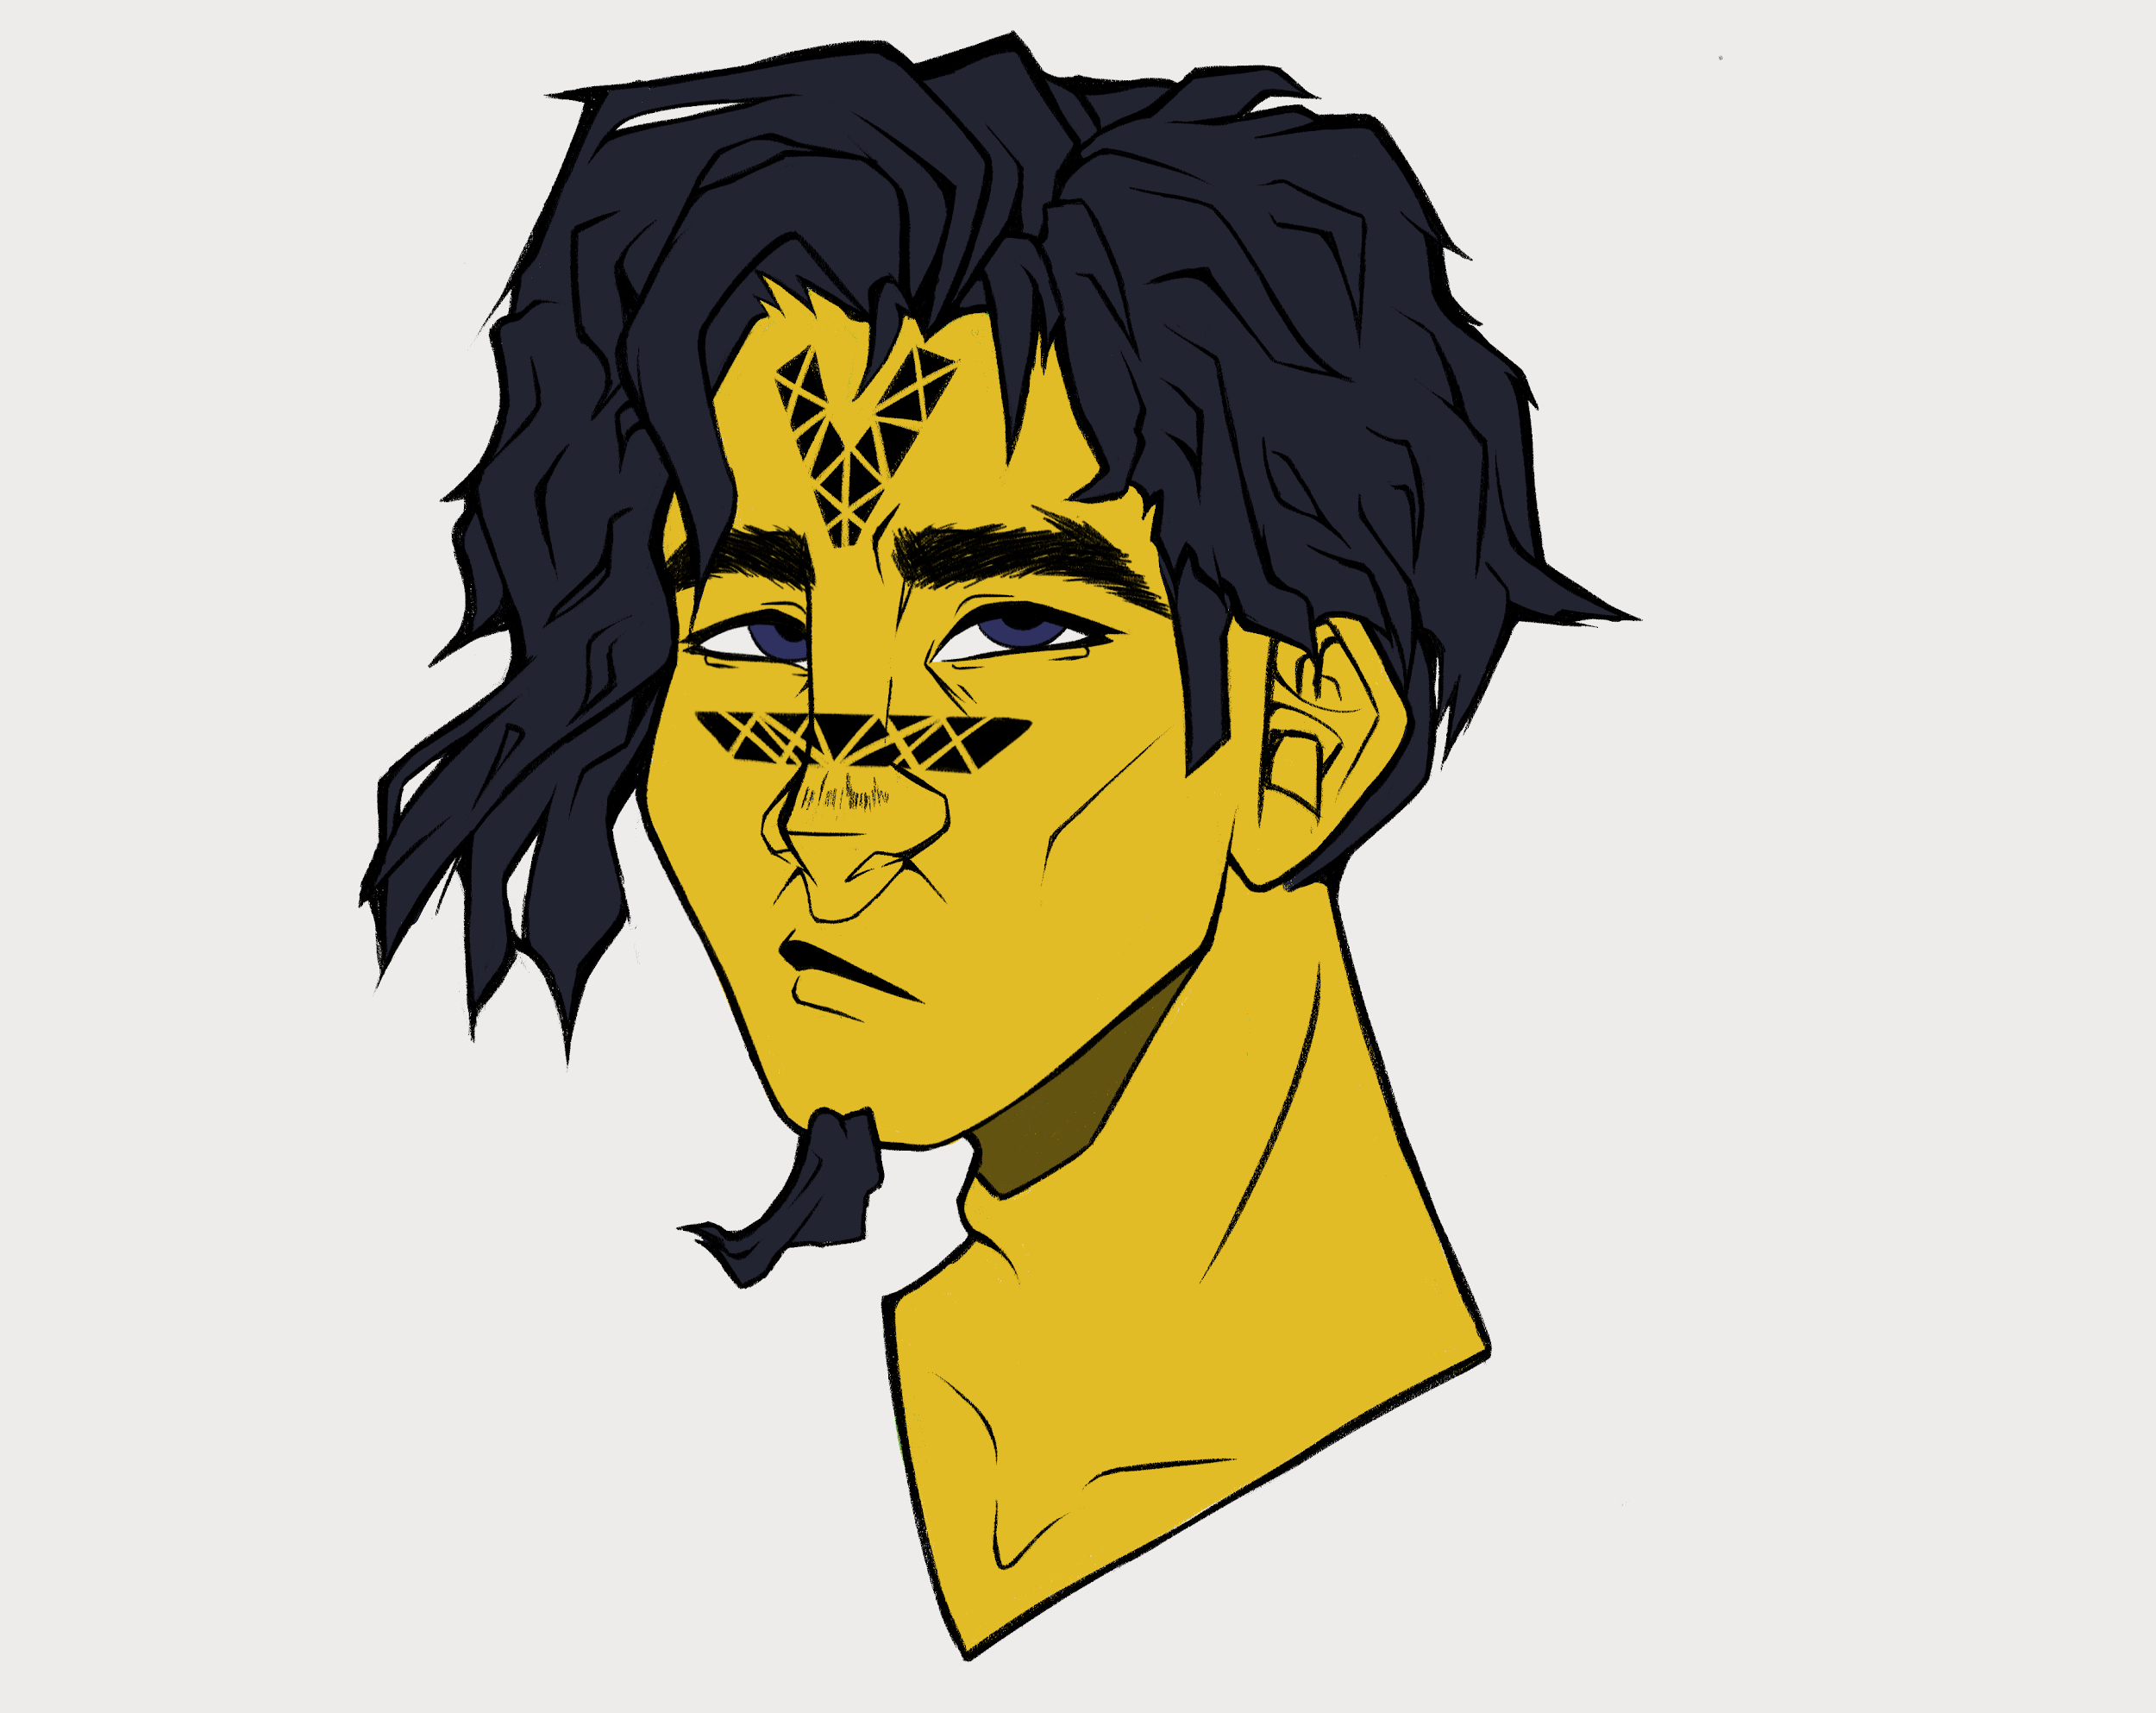
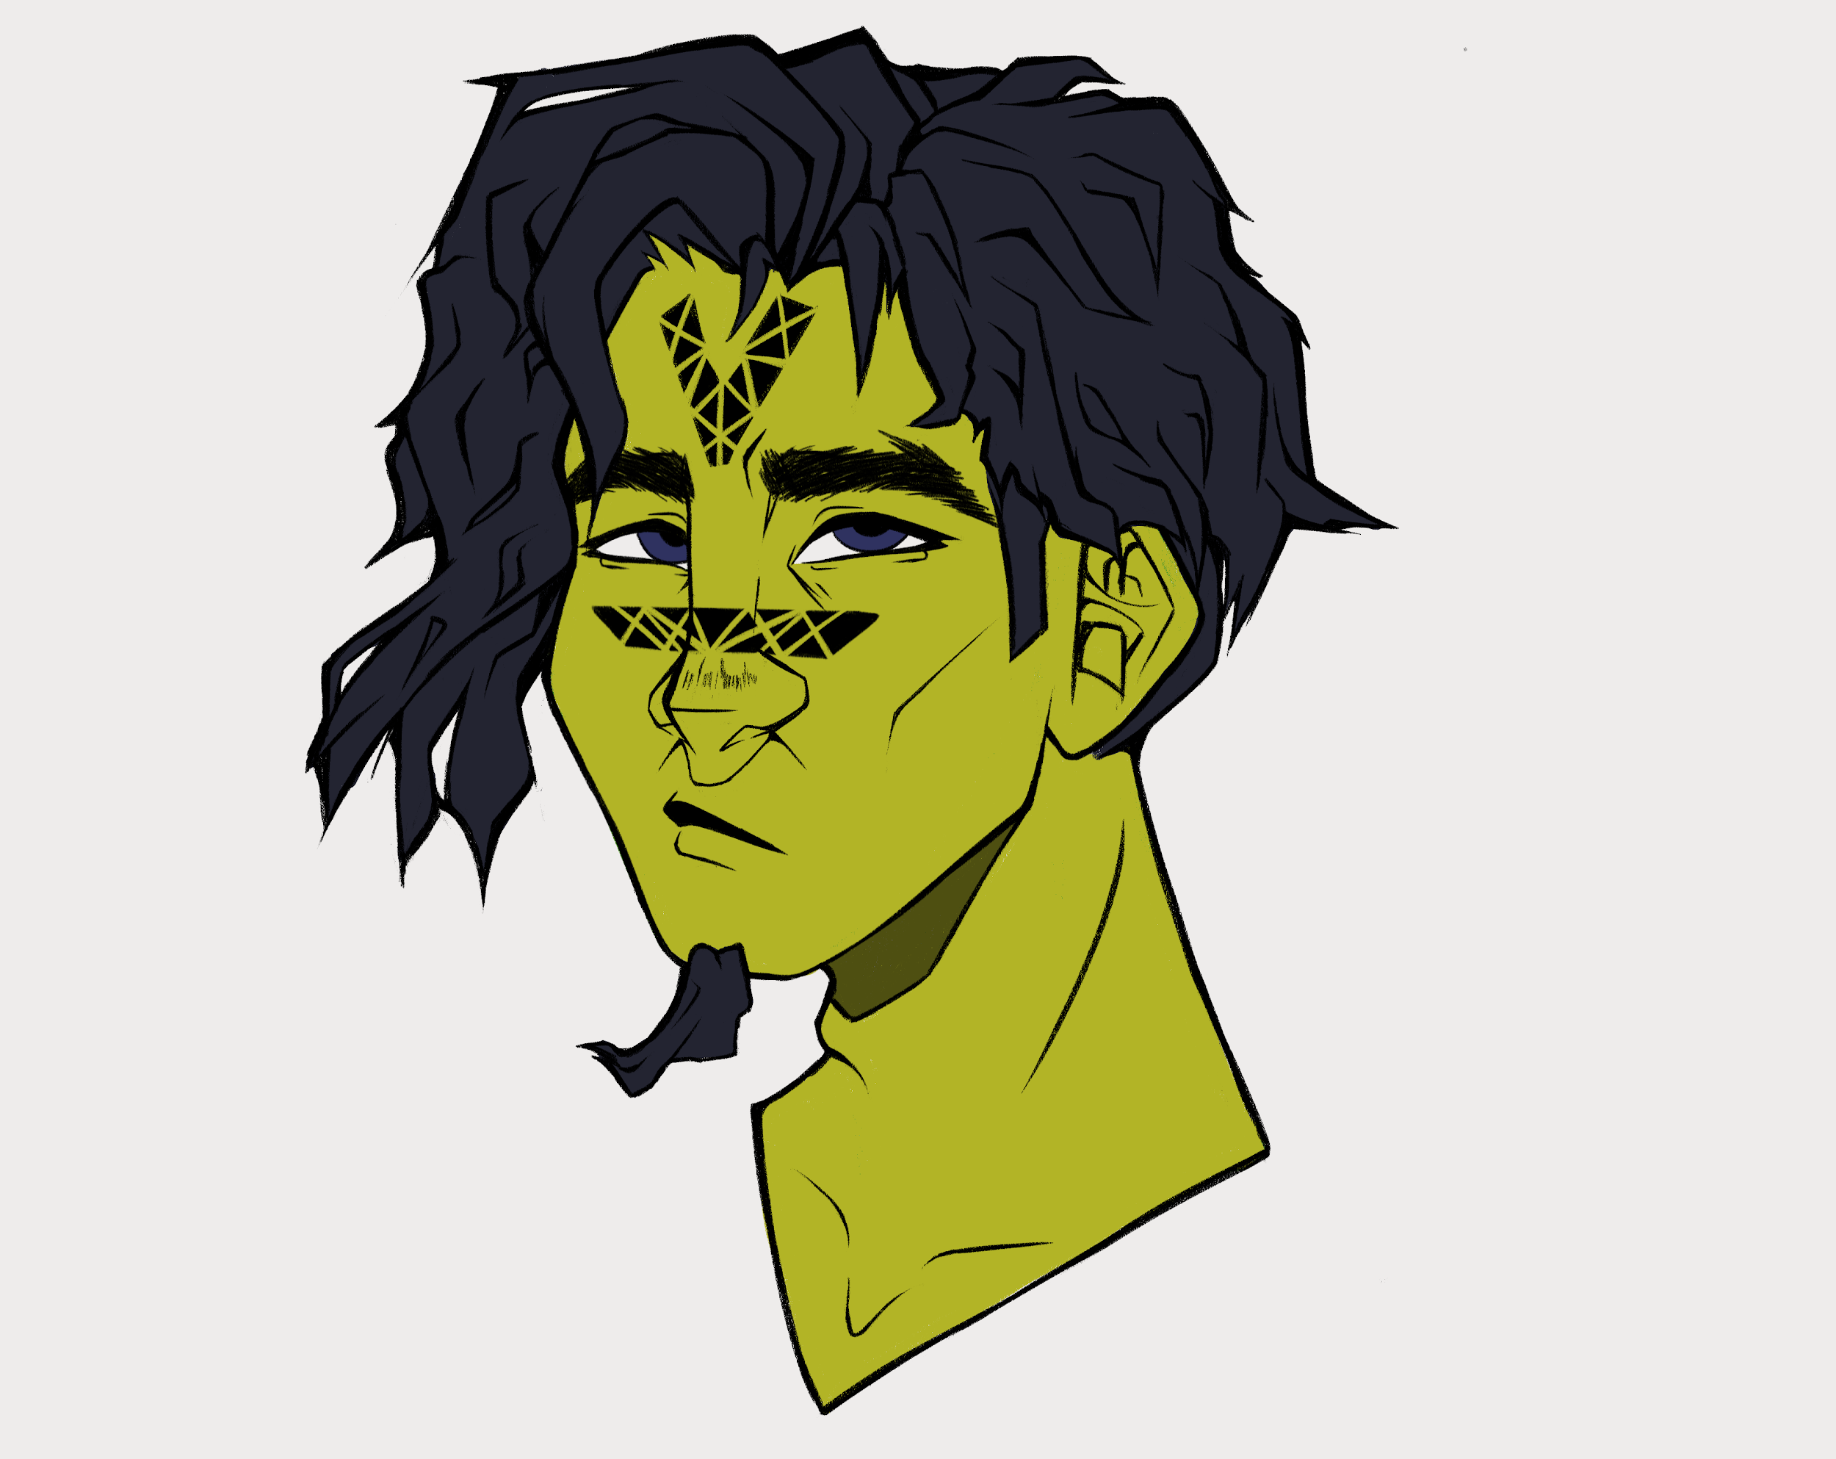
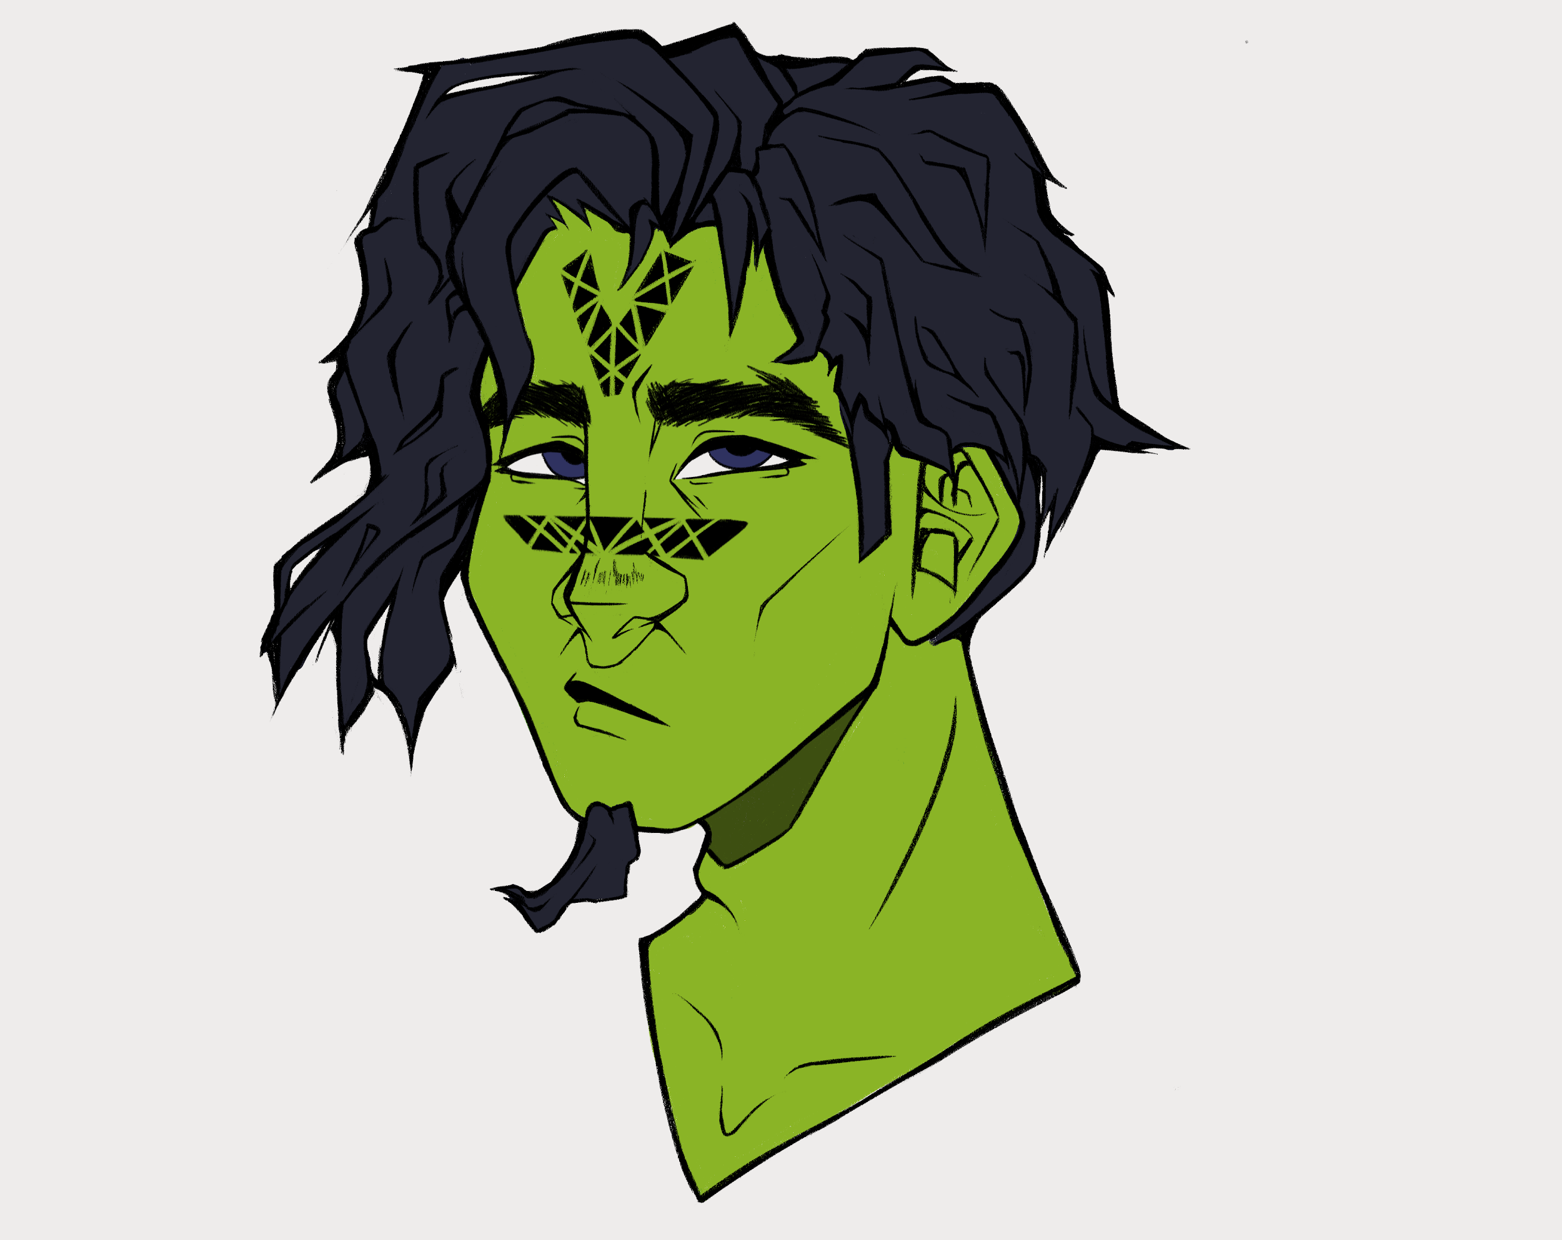
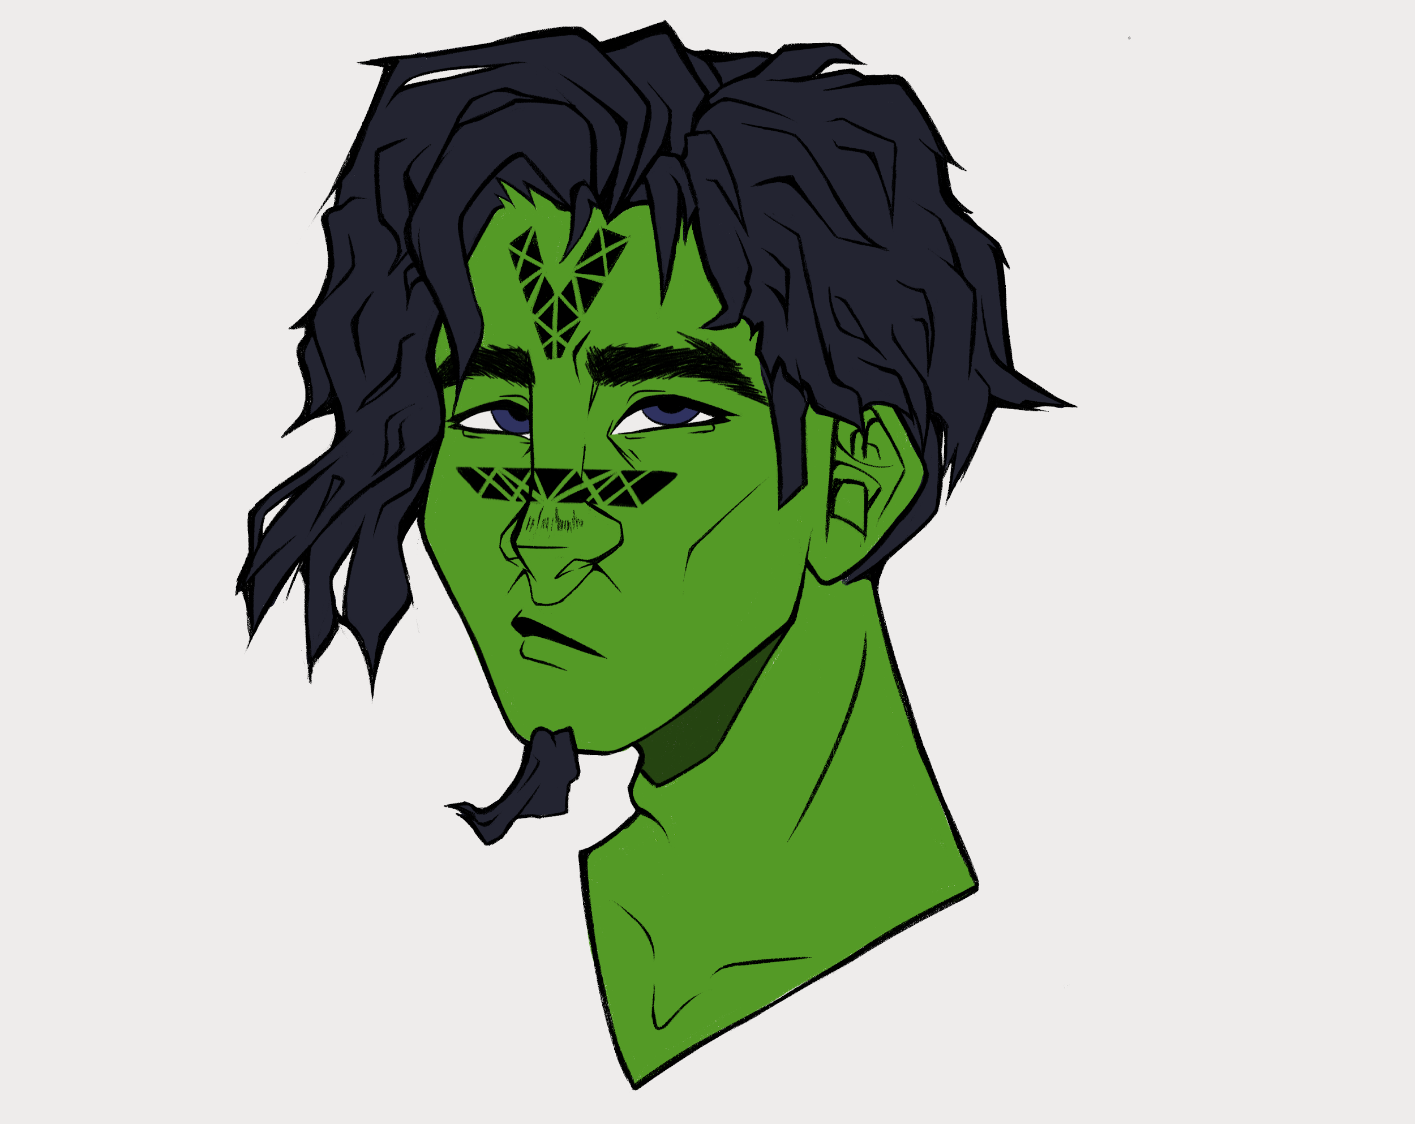
Mirialan
A big inspiration I took from this character, personality-wise, is Nathan Drake from the uncharted games. He is going to be a thief helping the main character.
For now I have 4 skin tone variations in mind and I will settle on one once I have designed his outfit as well. I am considering him being a runaway Jedi during the rebellion that will do anything he can to mess with the Empire, so he decides to join the main character in her mission.
I really liked evil Rey ‘s lightsaber from The Rise of Skywalker, so his lightsaber design will be based on it. As for the color of his blade, I think cyan will be the best option. “Since it is between blue and green, it also stands for a Jedi who has balanced skill between the Force and combat.” (Tim, 2023, Star Wars: Lightsaber Color Meanings) since his fighting style will combine both the use of Force and hand-to-hand combat.

Slide 9
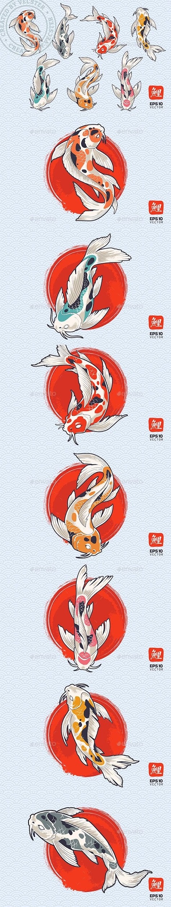
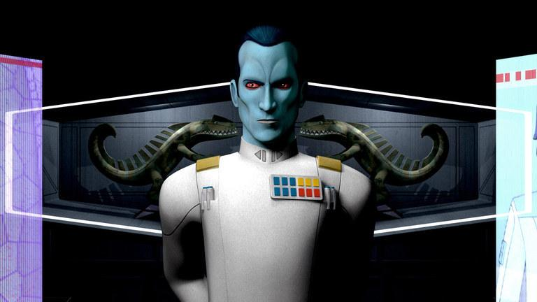
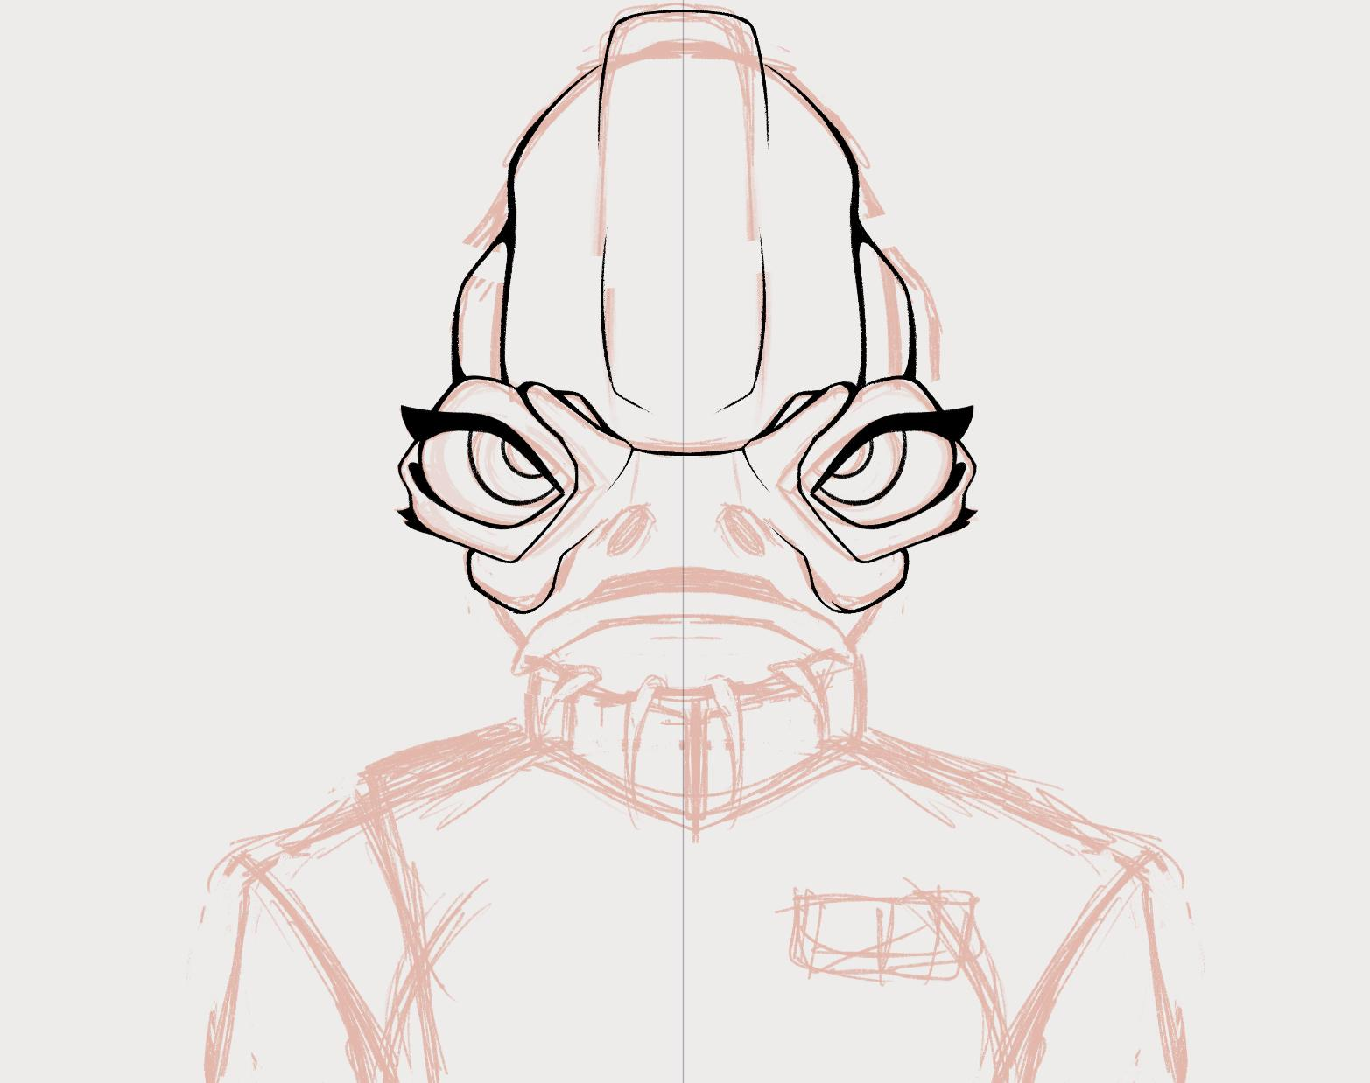
Mon Calamari
In Star Wars we’ve seen Mon Calamari people usually on the good side of the battle, so I wanted to create an evil character of this species.
She is going to be the shortest out of all the characters I’m designing, but looks can be deceiving and she is for sure someone to be feared. She joined the Empire not because she believes in what it stands for, but just because she wants to see the world burn.
She is on the higher end on the power ladder in the Empire and she has a lot of experience inflicting fear into the people in the corner of the Galaxy she’s been assigned to oversee.
One of the main inspirations for her personality is the character Thrawn, seen in Star Wars: Rebels.
Her color palette is tipical to the Empire, with a white shirt and black pants. For her skin color, I want to do something a bit different to what they usually look like. Instead of the classic brown Mon Calamari, she will have a koi fish-inspired pattern on her skin.

Slide 10
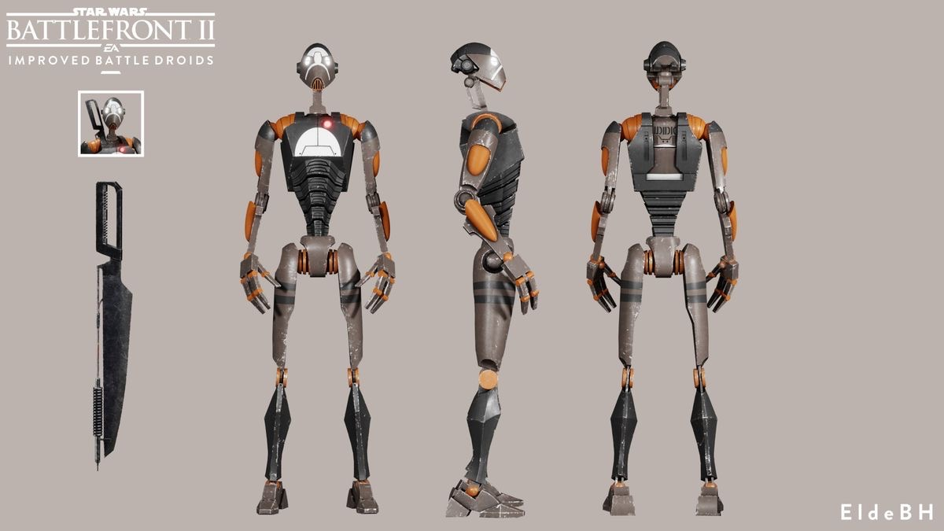
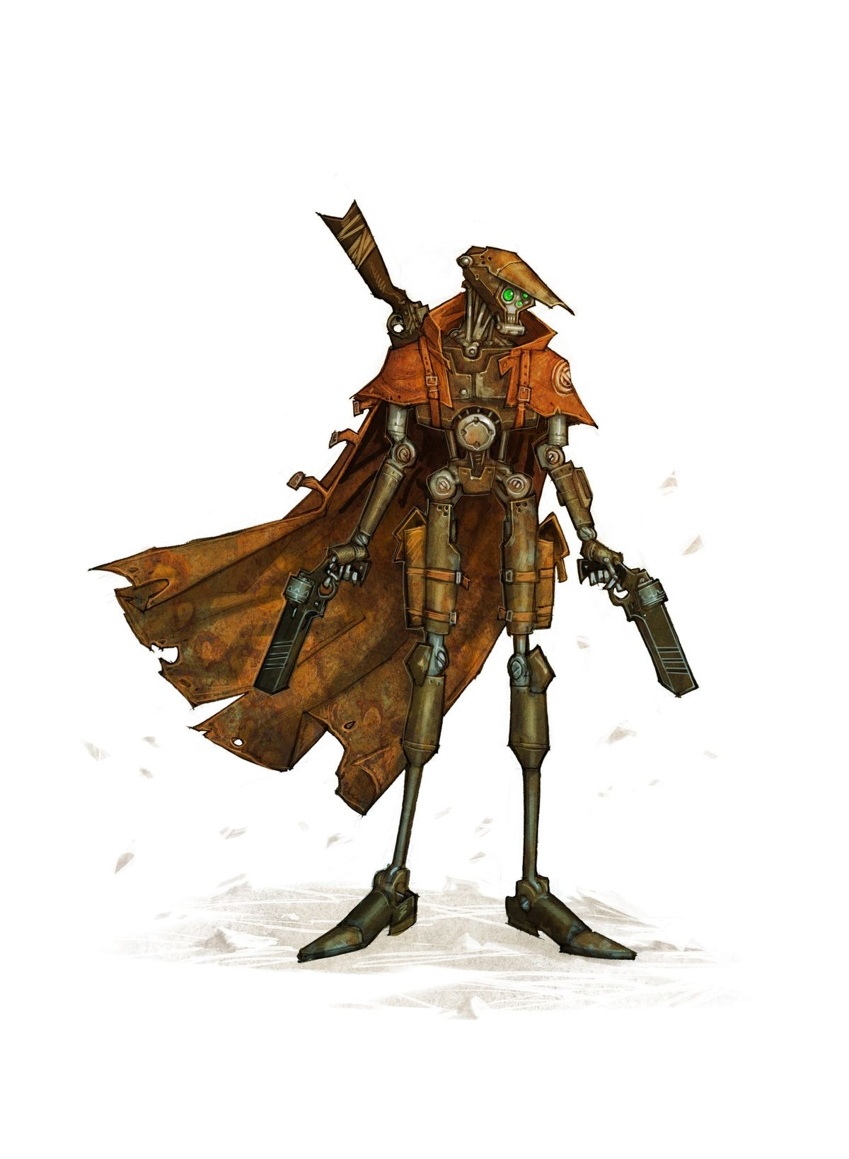
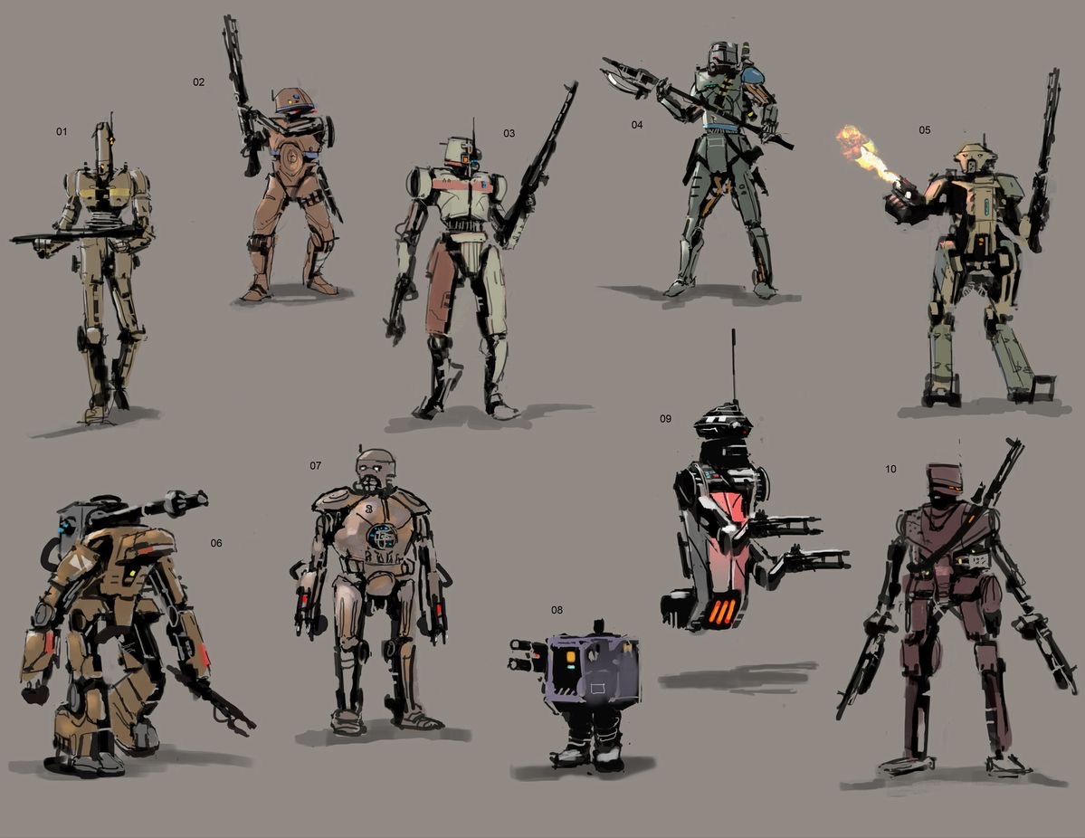
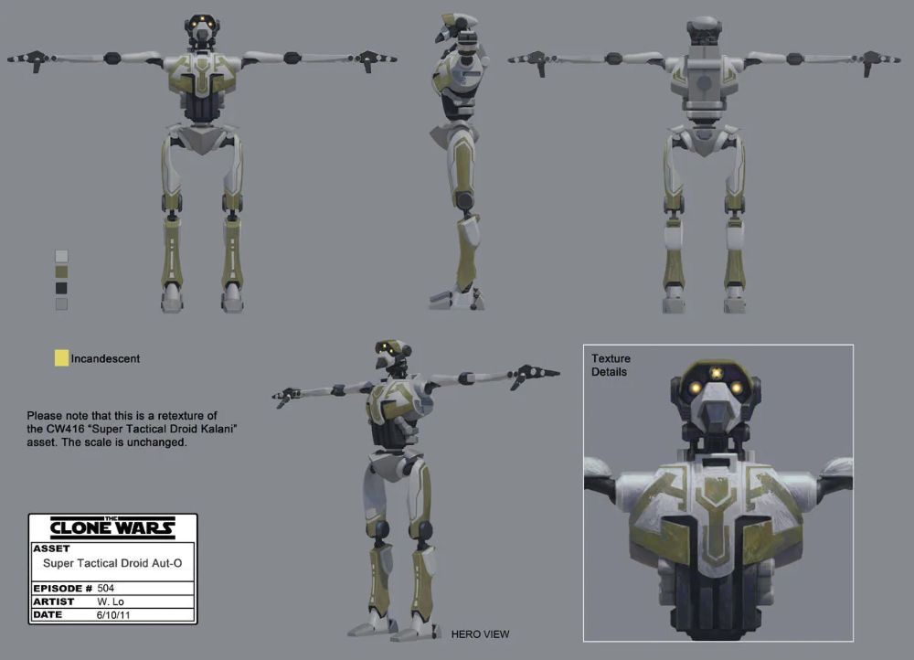
Bounty hunter droid
For this character, I’m thinking of designing a “recycled” battle droid of sorts. I imagine it’s main task would be to track down the main character and whoever is helping her and claim the bounty on their heads.
This droid will be a bit different than the usual battle droids we see, mainly because it was reprogrammed in a way to have some sort of feelings and free will, which I plan to show in a little clothing they chose for themselves, maybe a cape like in the picture below, or a jacket.

Slide 11
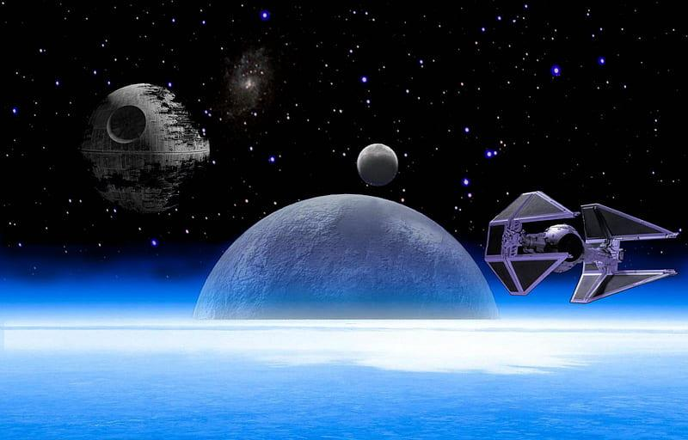
New planet, its ecosystem & native species

Slide 12
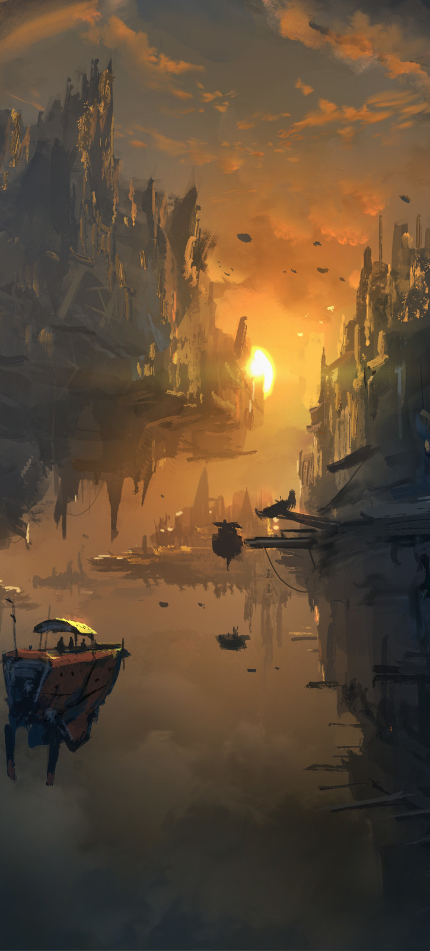
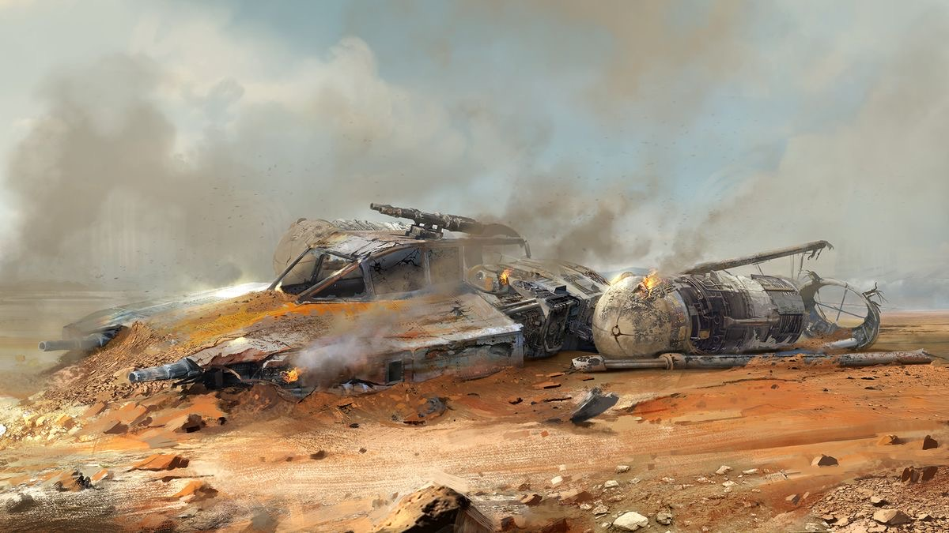
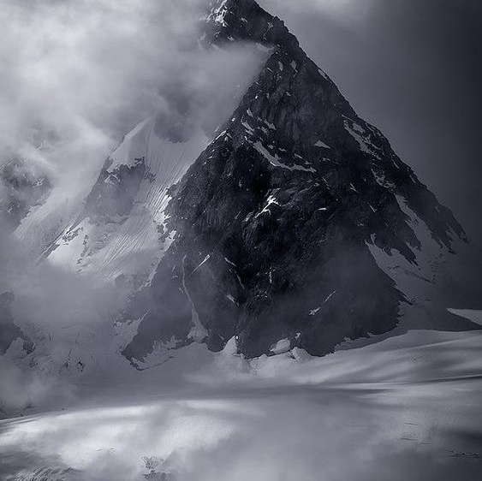
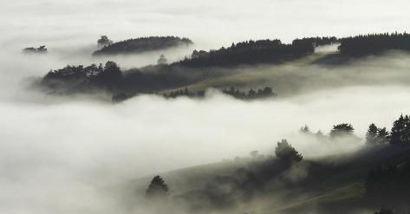
The floating islands planet
The lack of accessibility makes the rebellion pick this planet for their new base. It has very harsh living conditions, it’s a very foggy place with limited vision. There are crashed and destroyed spaceships of various sizes almost everywhere, some covered by vegetation.
This new planet that I am designing is going to be made out of floating islands, seemingly having no bottom or core and known for being basically a spaceship grave because of all the fog that makes it very difficult to navigate it unless you’ve been there before and know exactly where you’re going.

Slide 13
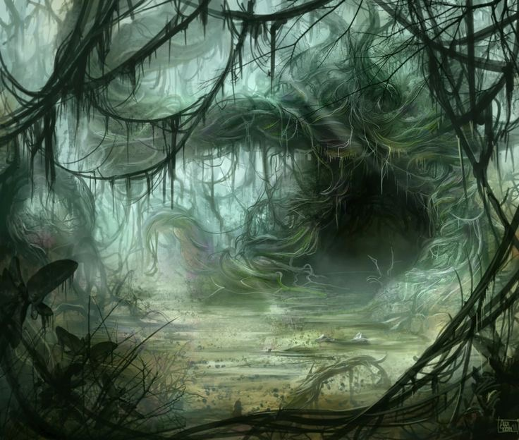
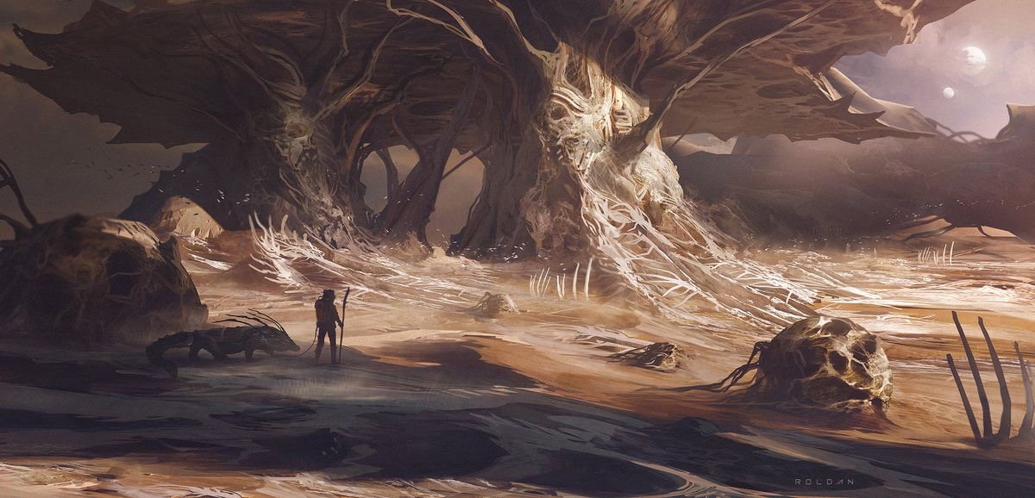
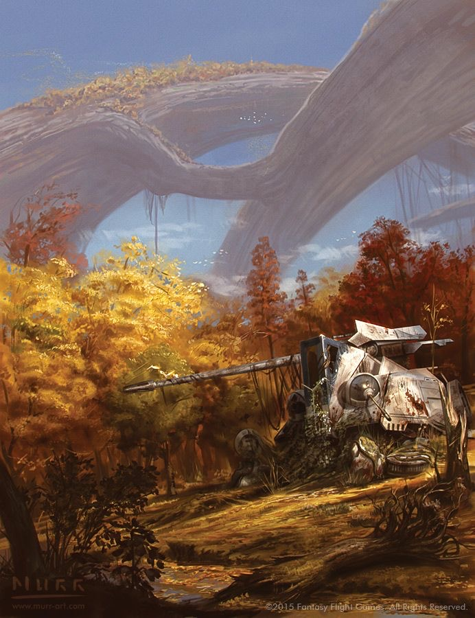
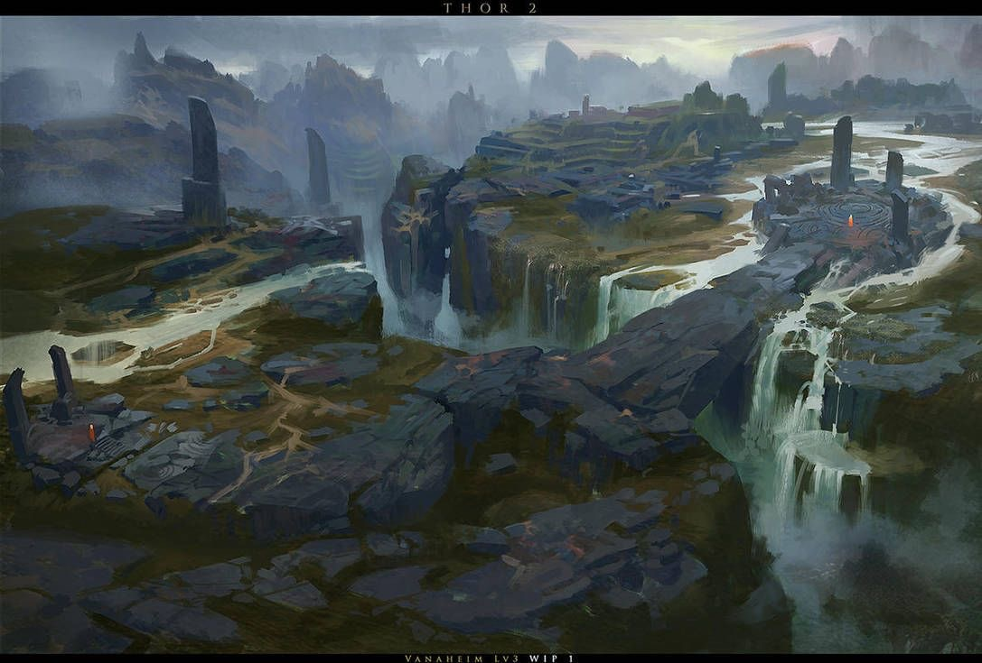
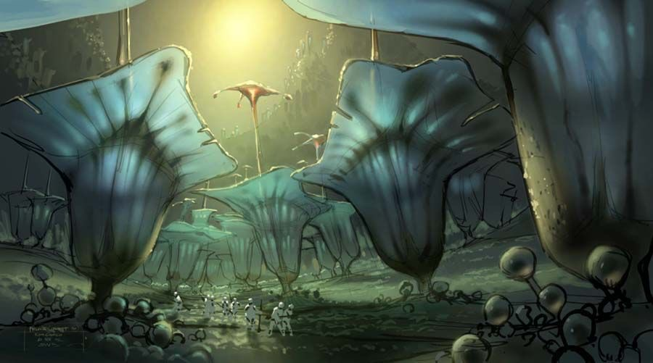
Flora

Slide 14
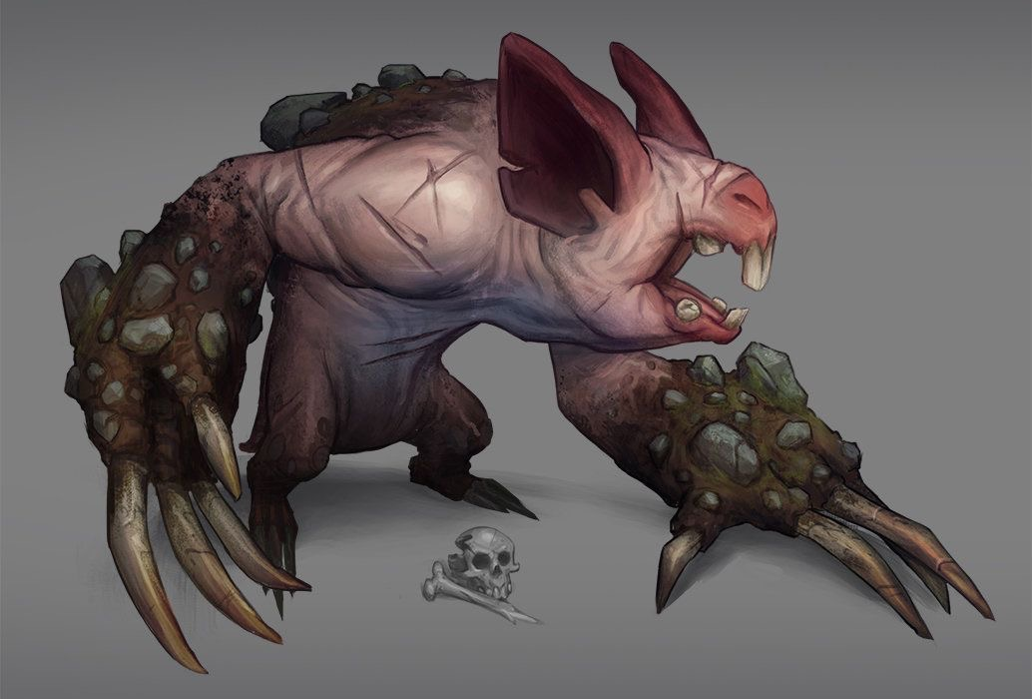
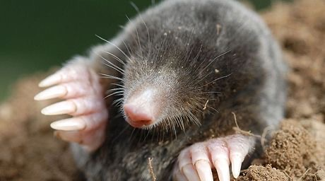
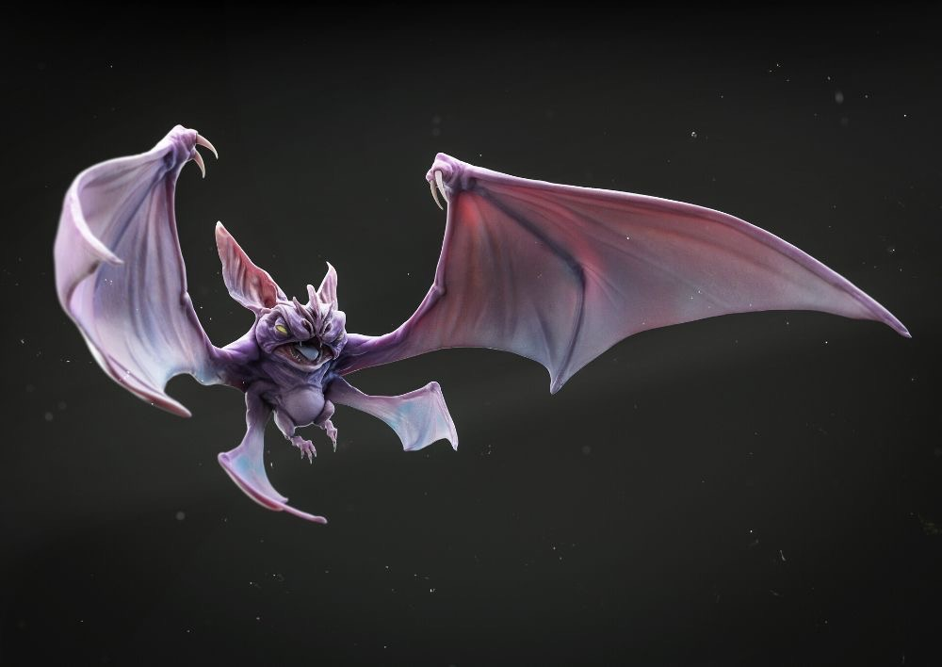
Fauna
Since the planet is always foggy and has very limited vision, I will design the fauna based on blind animals on Earth because they would have no need for eyes. Instead they could use echolocation, smell etc. to get around.
One of the animals I will be basing them on is the mole and just like them, would live mostly underground and build tunnels. Since they wouldn’t be able to get from one floating island to the other one, I think they could all vary a little bit from island to island. For example, on the biggest islands they could be massive, while on the smallest they would be tiny, enough to fit in a pocket.
Just like the mole, they will have black velvety fur, but I’m not excluding the possibility of making some of them bald, like in one of the pictures down below.
Another animal I have in mind is the bat. These aliens would be able to travel from island to island, so there would be no need to differentiate them design-wise.

Slide 15
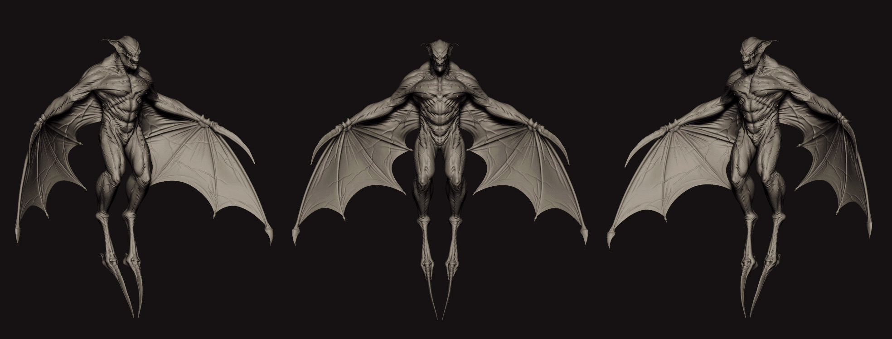
New alien species
I have similar ideas for the humanoid alien species native to this planet and I will be following the same matrix as Terryl Whitlatch (the original alien designers for Star Wars ) and base them on an already existing animal on Earth, just like I did with the fauna.
They would have large, bat-like ears and a very good sense of smell and hearing. I am thinking of making them blind or poor-sighted as well since they would not need to rely on sight on their home planet.
They obviously know how to navigate and because they don’t want the Empire invading their home, they decide to help out the group of rebels, allowing them to set a base on their home planet and teaching them how to get around in their spaceships without crashing.

Slide 16
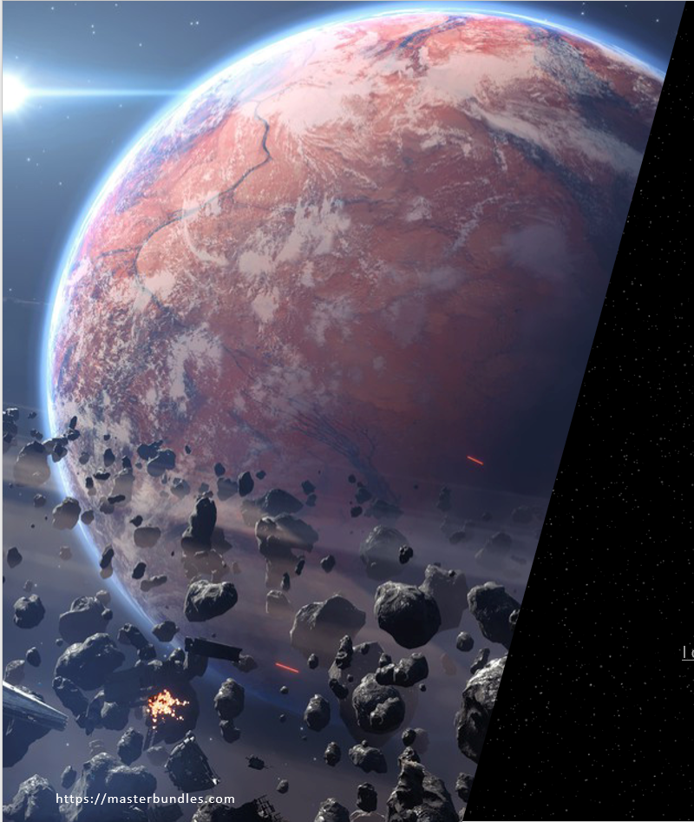
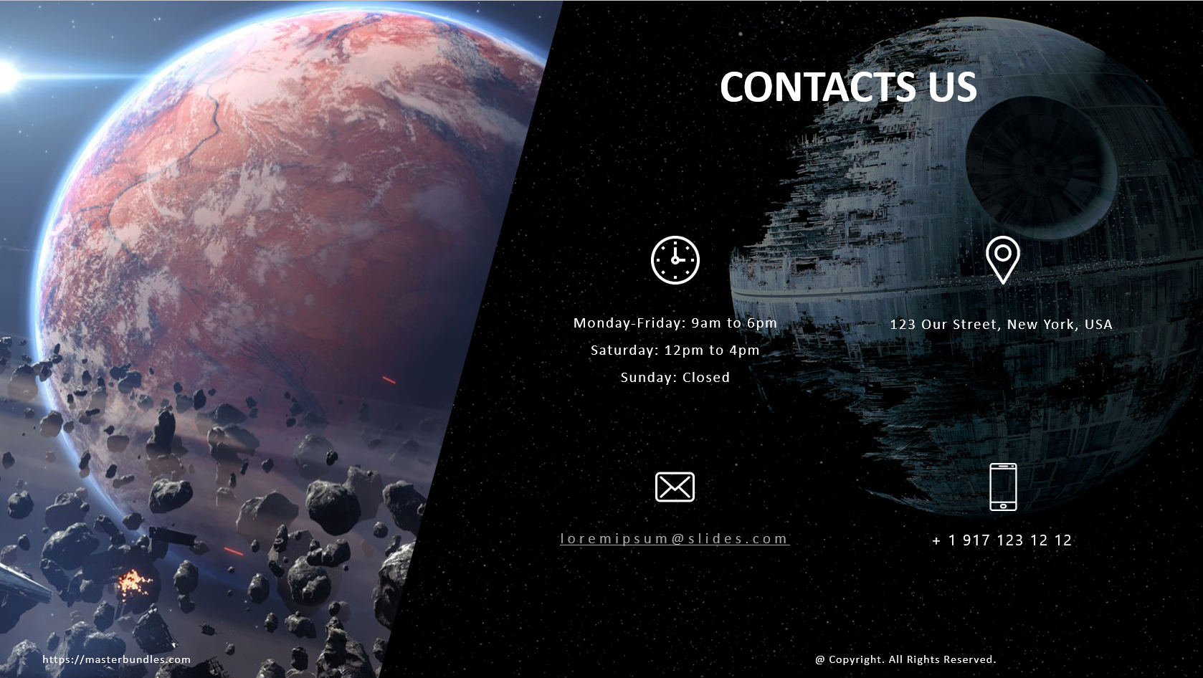
Any questions?

Slide 17
References
Raucci B. Diversity in Star Wars [Online], pp. 1
Available at: https://www.brianaraucci.com/writing/diversity-in-star-wars [Accessed: 3/03/2023]
Tim, 2023, Star Wars: Lightsaber Color Meanings [Online]
Available at: https://www.bossksbounty.com/films/every-lightsaber-color-in-star-wars [Accessed: 4/03/2023]
Pictures:
https://pin.it/7xhSvGu https://pin.it/Idk3gTm https://pin.it/2PTd2UY https://pin.it/4yZMy7o https://pin.it/3eA61gE https://pin.it/5Hrd8e1 https://pin.it/4oMXqF1. https://pin.it/4FjcBfo. https://pin.it/2bQa3zK https://pin.it/1d4elBF https://pin.it/1nyCLIp https://pin.it/1YKL26g https://pin.it/1fR27QE https://pin.it/2HCQ8xs https://pin.it/6GBBi2J https://pin.it/2GO6yVX https://pin.it/3hktfsS https://pin.it/1jsoEDL https://pin.it/4ySvUB1 https://pin.it/6UonOKN https://pin.it/54mdFna https://pin.it/tISyd3L https://pin.it/VmK37YZ. https://pin.it/wI7zgJ8. https://pin.it/4hdwqEC https://pin.it/6YtMC0U https://pin.it/5Fb75aS. https://pin.it/4GCtlgx. https://pin.it/wELTxfb https://pin.it/2ZArrcQ https://pin.it/2rgtpfY https://pin.it/6G6zpcS https://pin.it/73hflg2 https://pin.it/6hD87qz https://pin.it/5wMRwLM https://pin.it/17LZZxk https://pin.it/4WF2oGy https://pin.it/Snd6ha2 https://pin.it/blbW4Rk
https://www.artstation.com/artwork/xz3Xw4
https://www.deviantart.com/0bo/art/THOR2-redsteam-2d-enviro-Vanaheim-Lv3-WIP01-412219104
https://www.deviantart.com/jakemurray/art/Legacy-of-Conflict-528661047
https://www.telegraph.co.uk/news/earth/environment/7824780/Mole-population-soars-due-to-poison-ban.html
https://www.artstation.com/artwork/R3gbm
https://www.artstation.com/artwork/6am5QV
https://www.zbrushcentral.com/t/obbis-sketchbook-2009/285482
https://masterbundles.com @ Copyright. All Rights Reserved.

